Slide 1
ALLENDALE ARTWORK
2020 SCHOOL YEAR

Slide 2
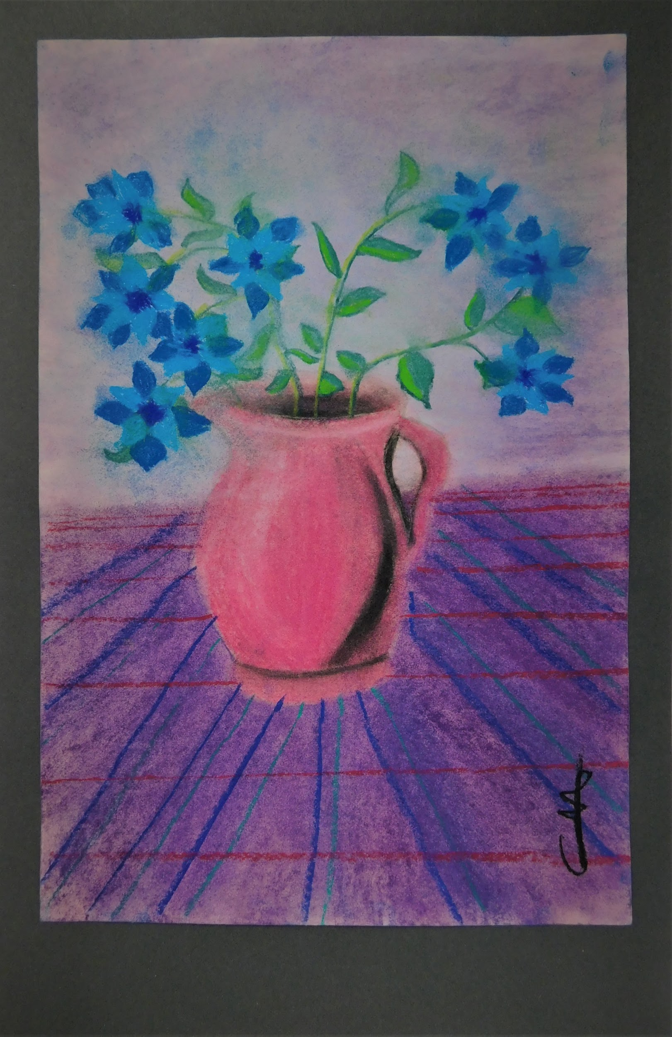
FORGET ME NOTS
(Drawing: Carmen M. - 9th Grade)

Slide 3
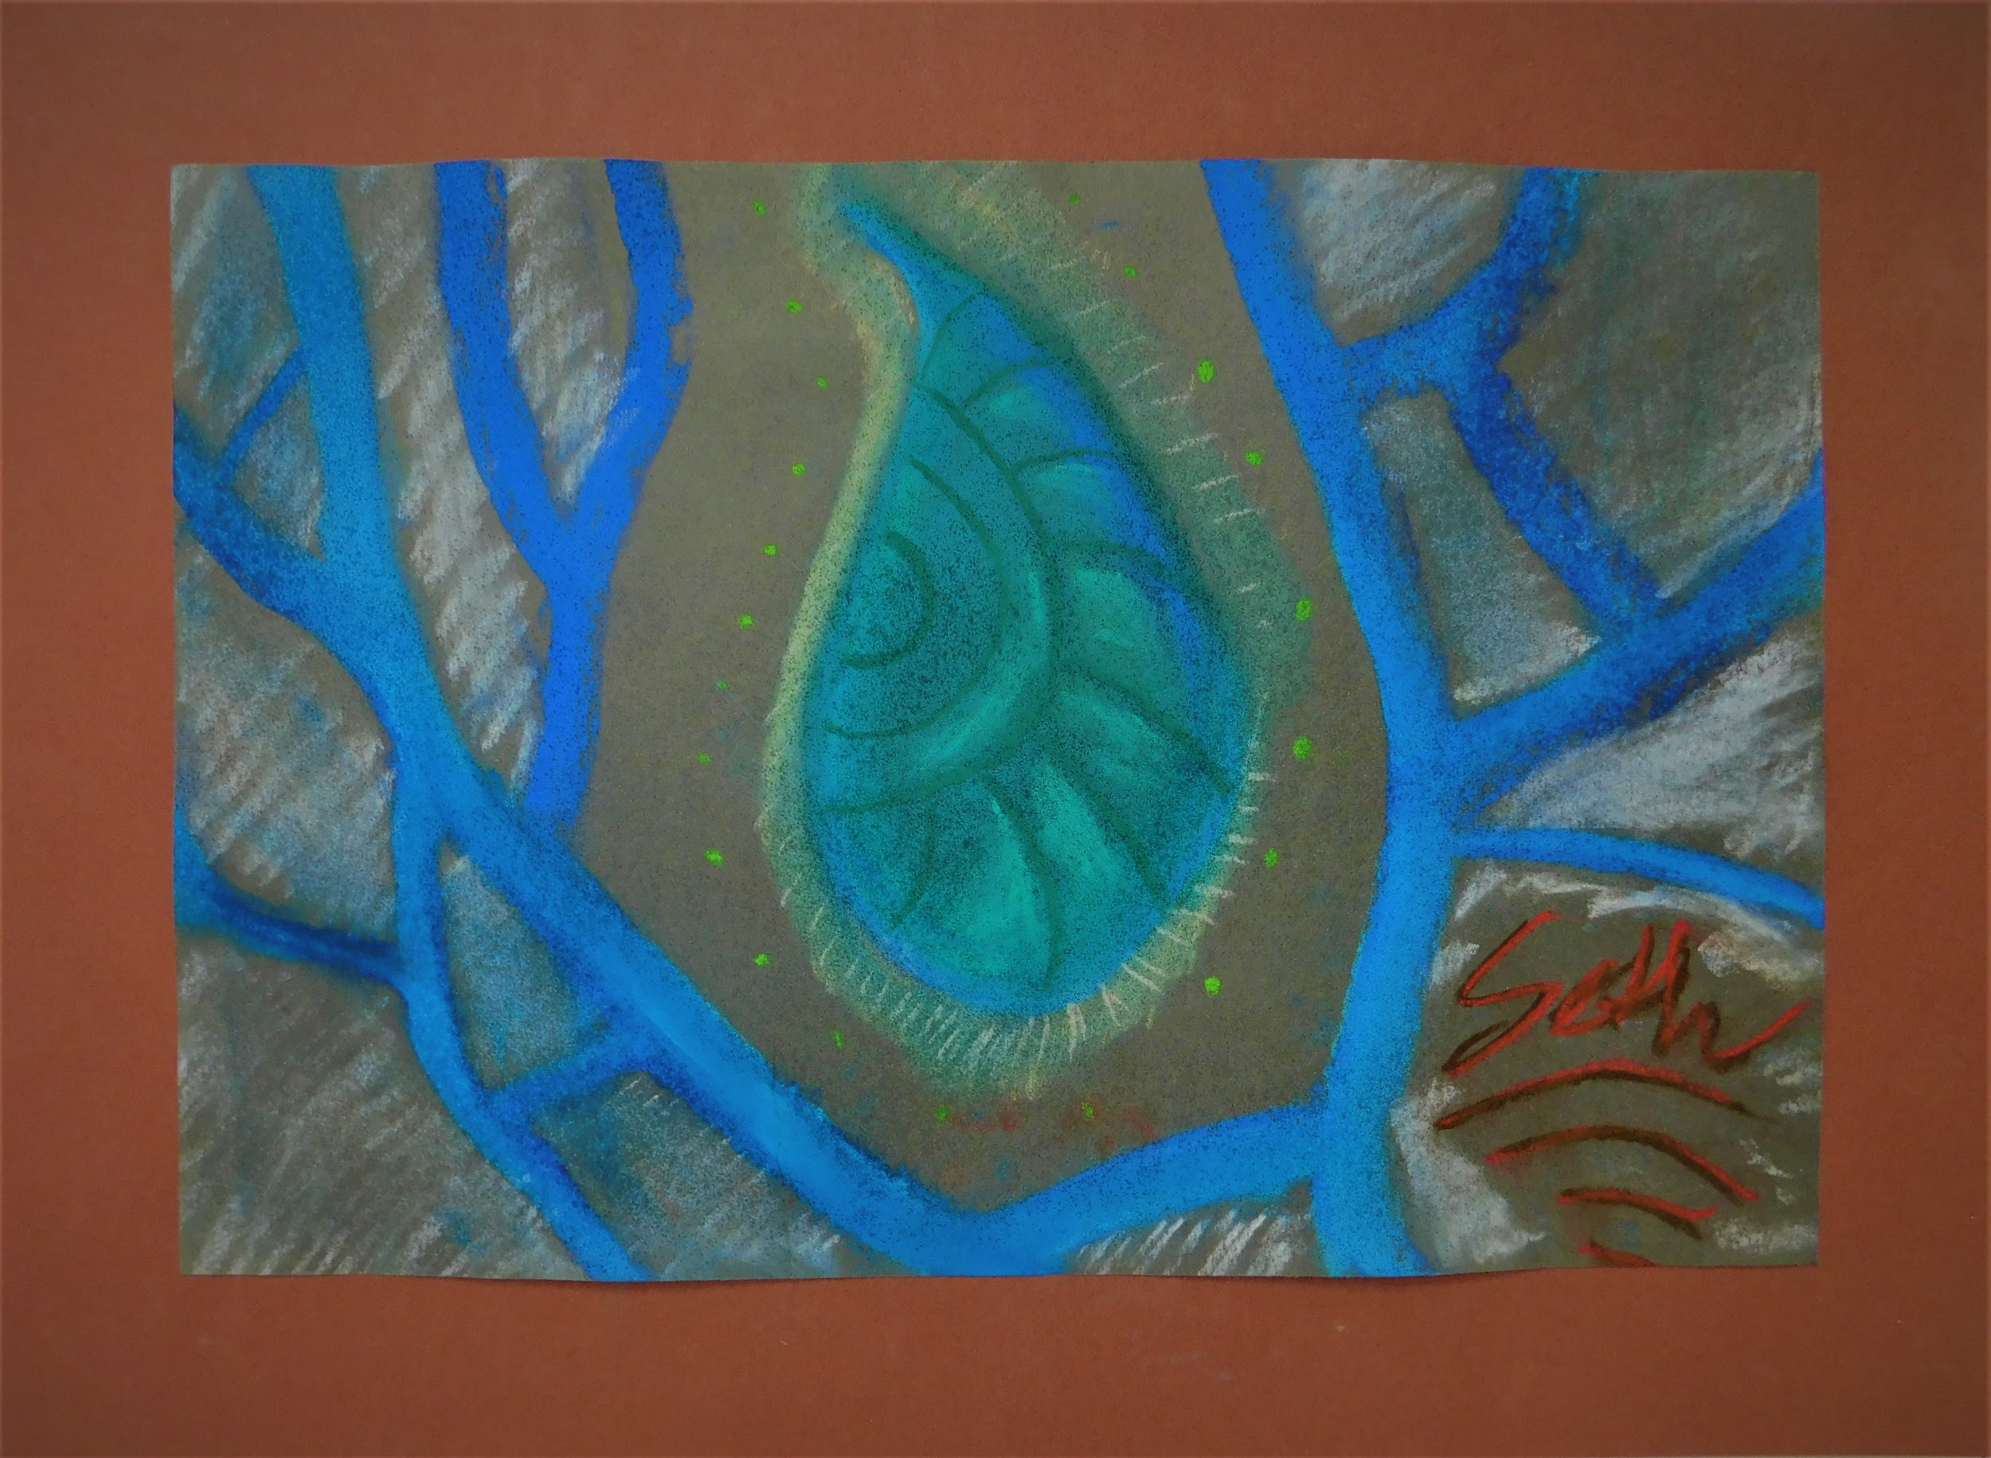
CELLULAR TEARS
(Drawing: Seth D. - 10th Grade)

Slide 4
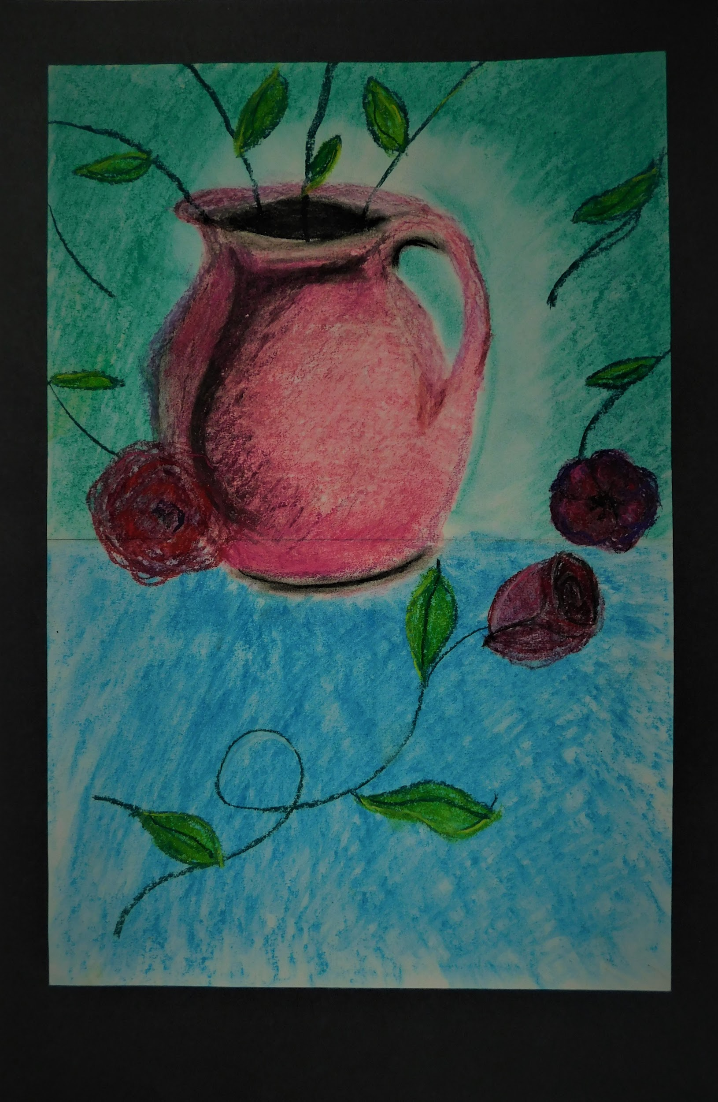
SHOWERING ROSES
(Drawing: Mileena S. - 11th Grade)

Slide 5
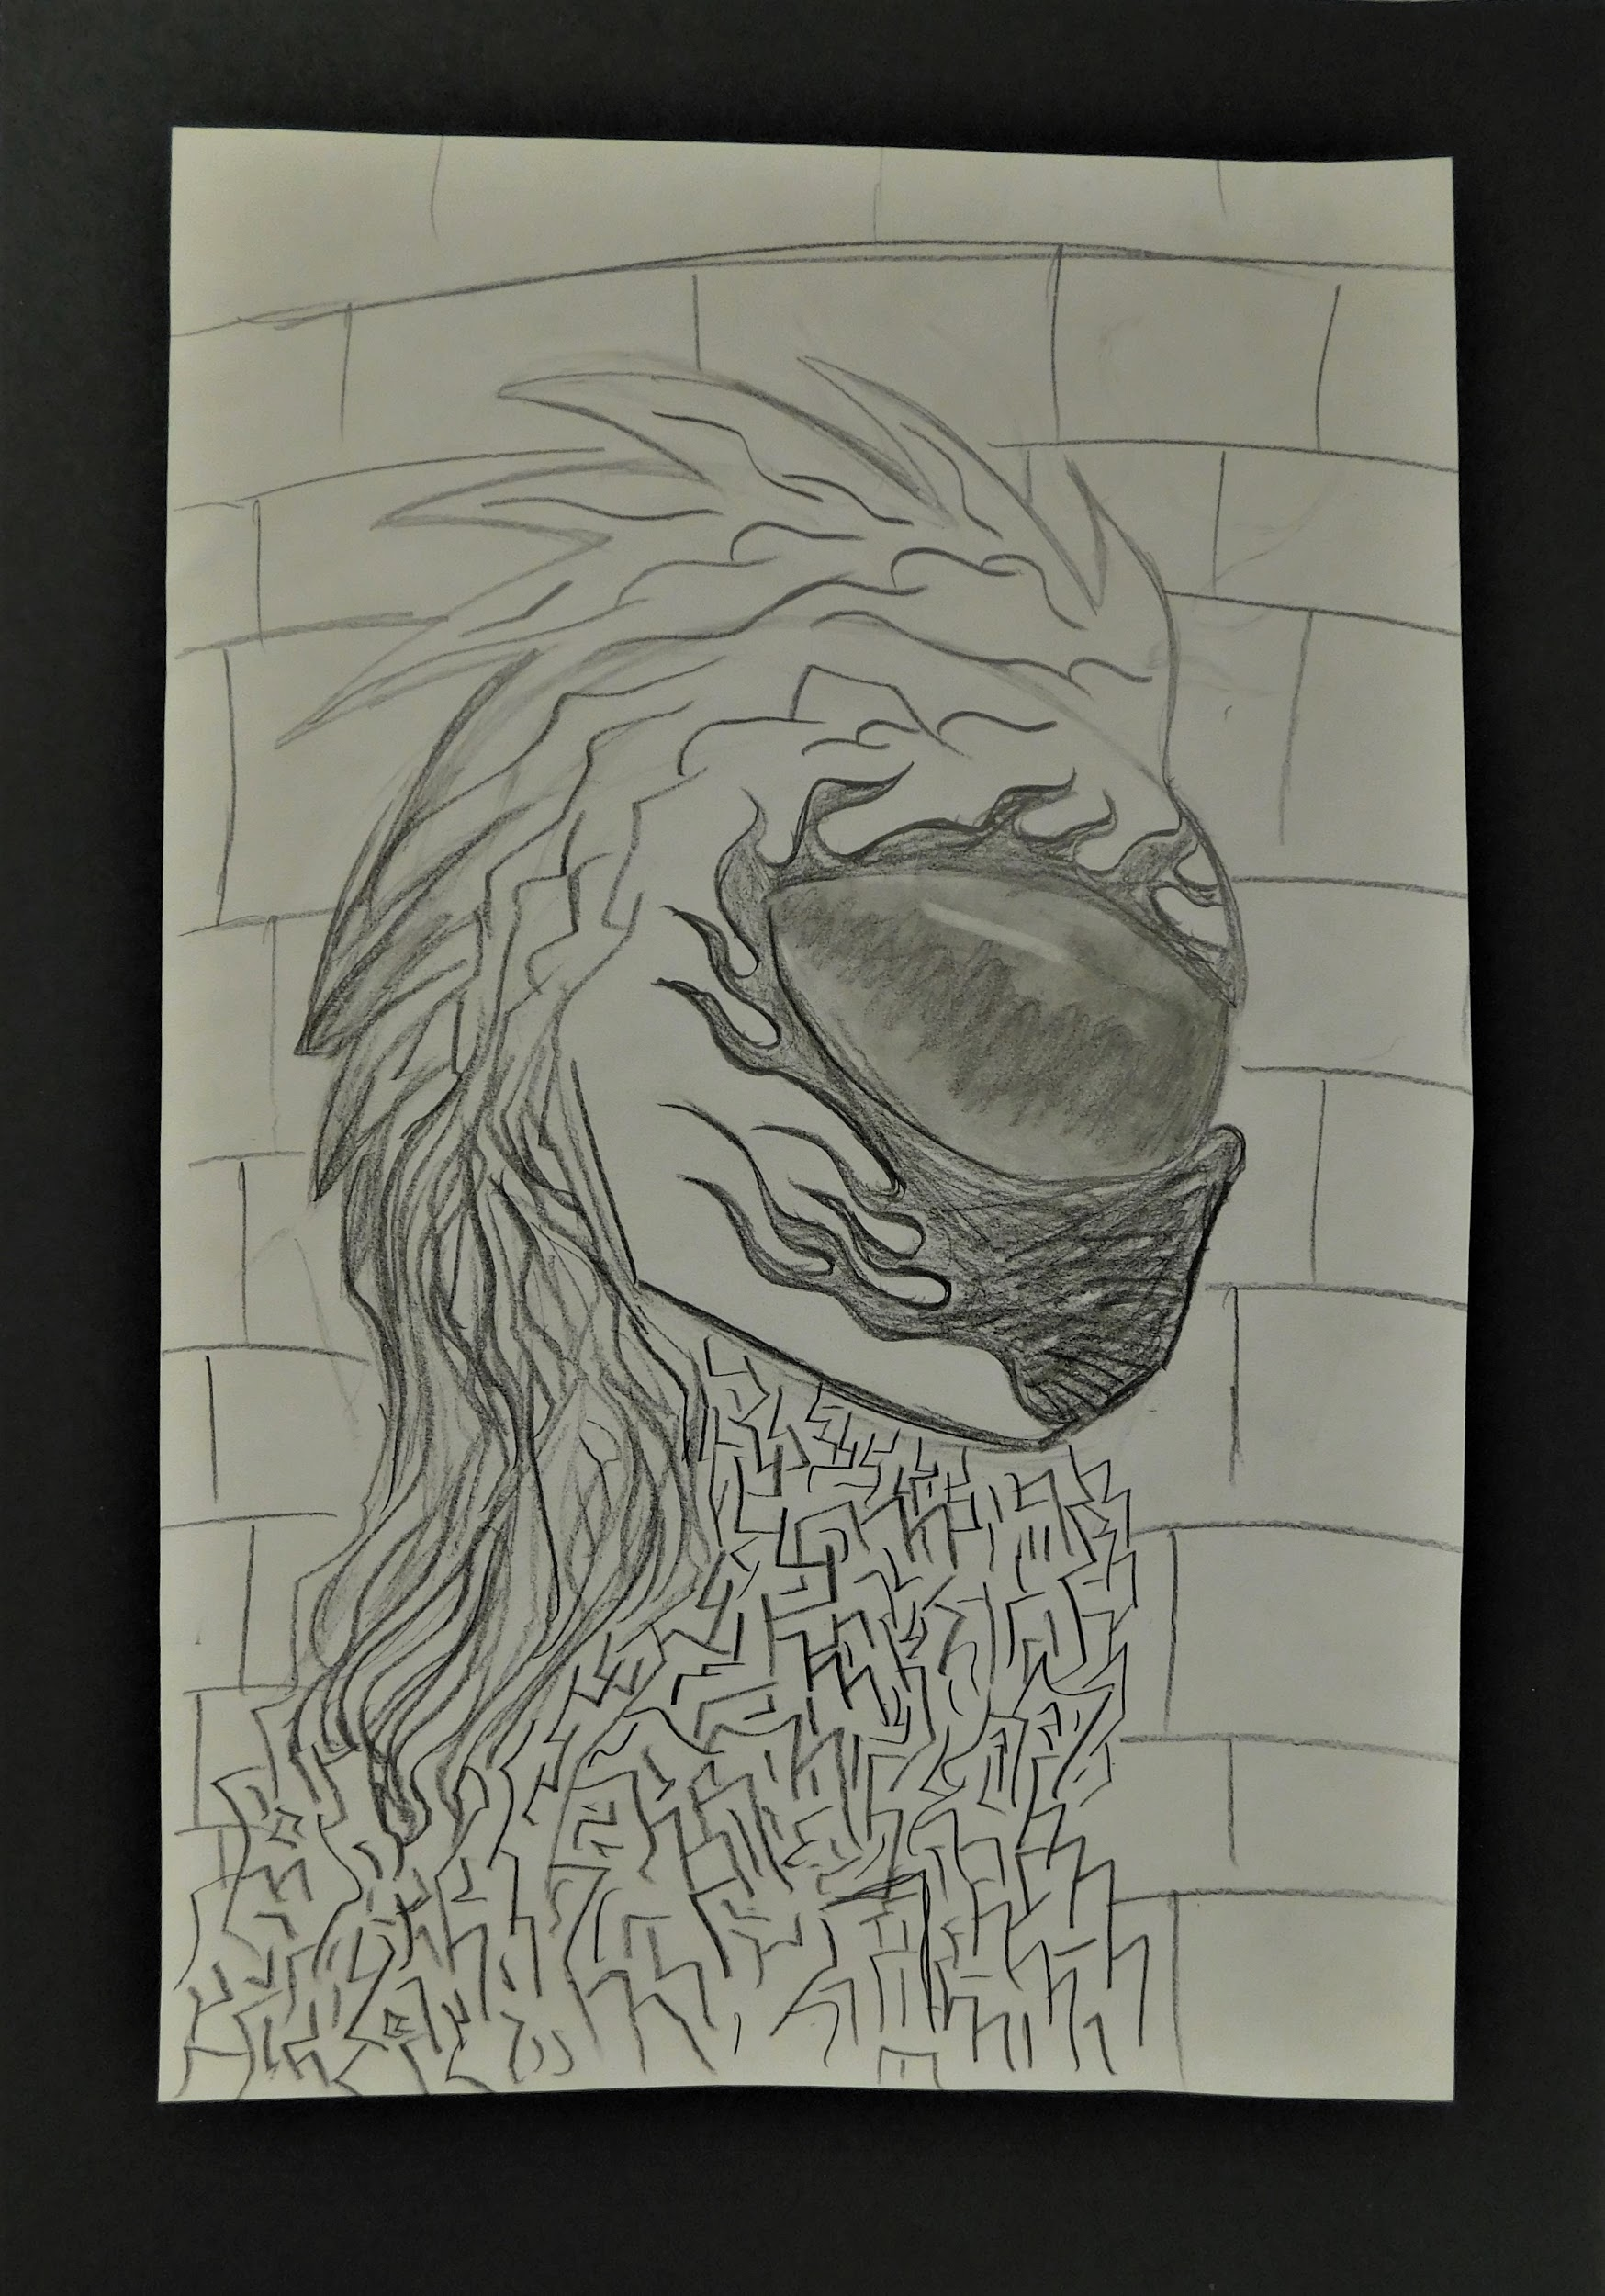
FLAMING ARMOR
(Drawing: Kendal D. - 10th Grade)

Slide 6
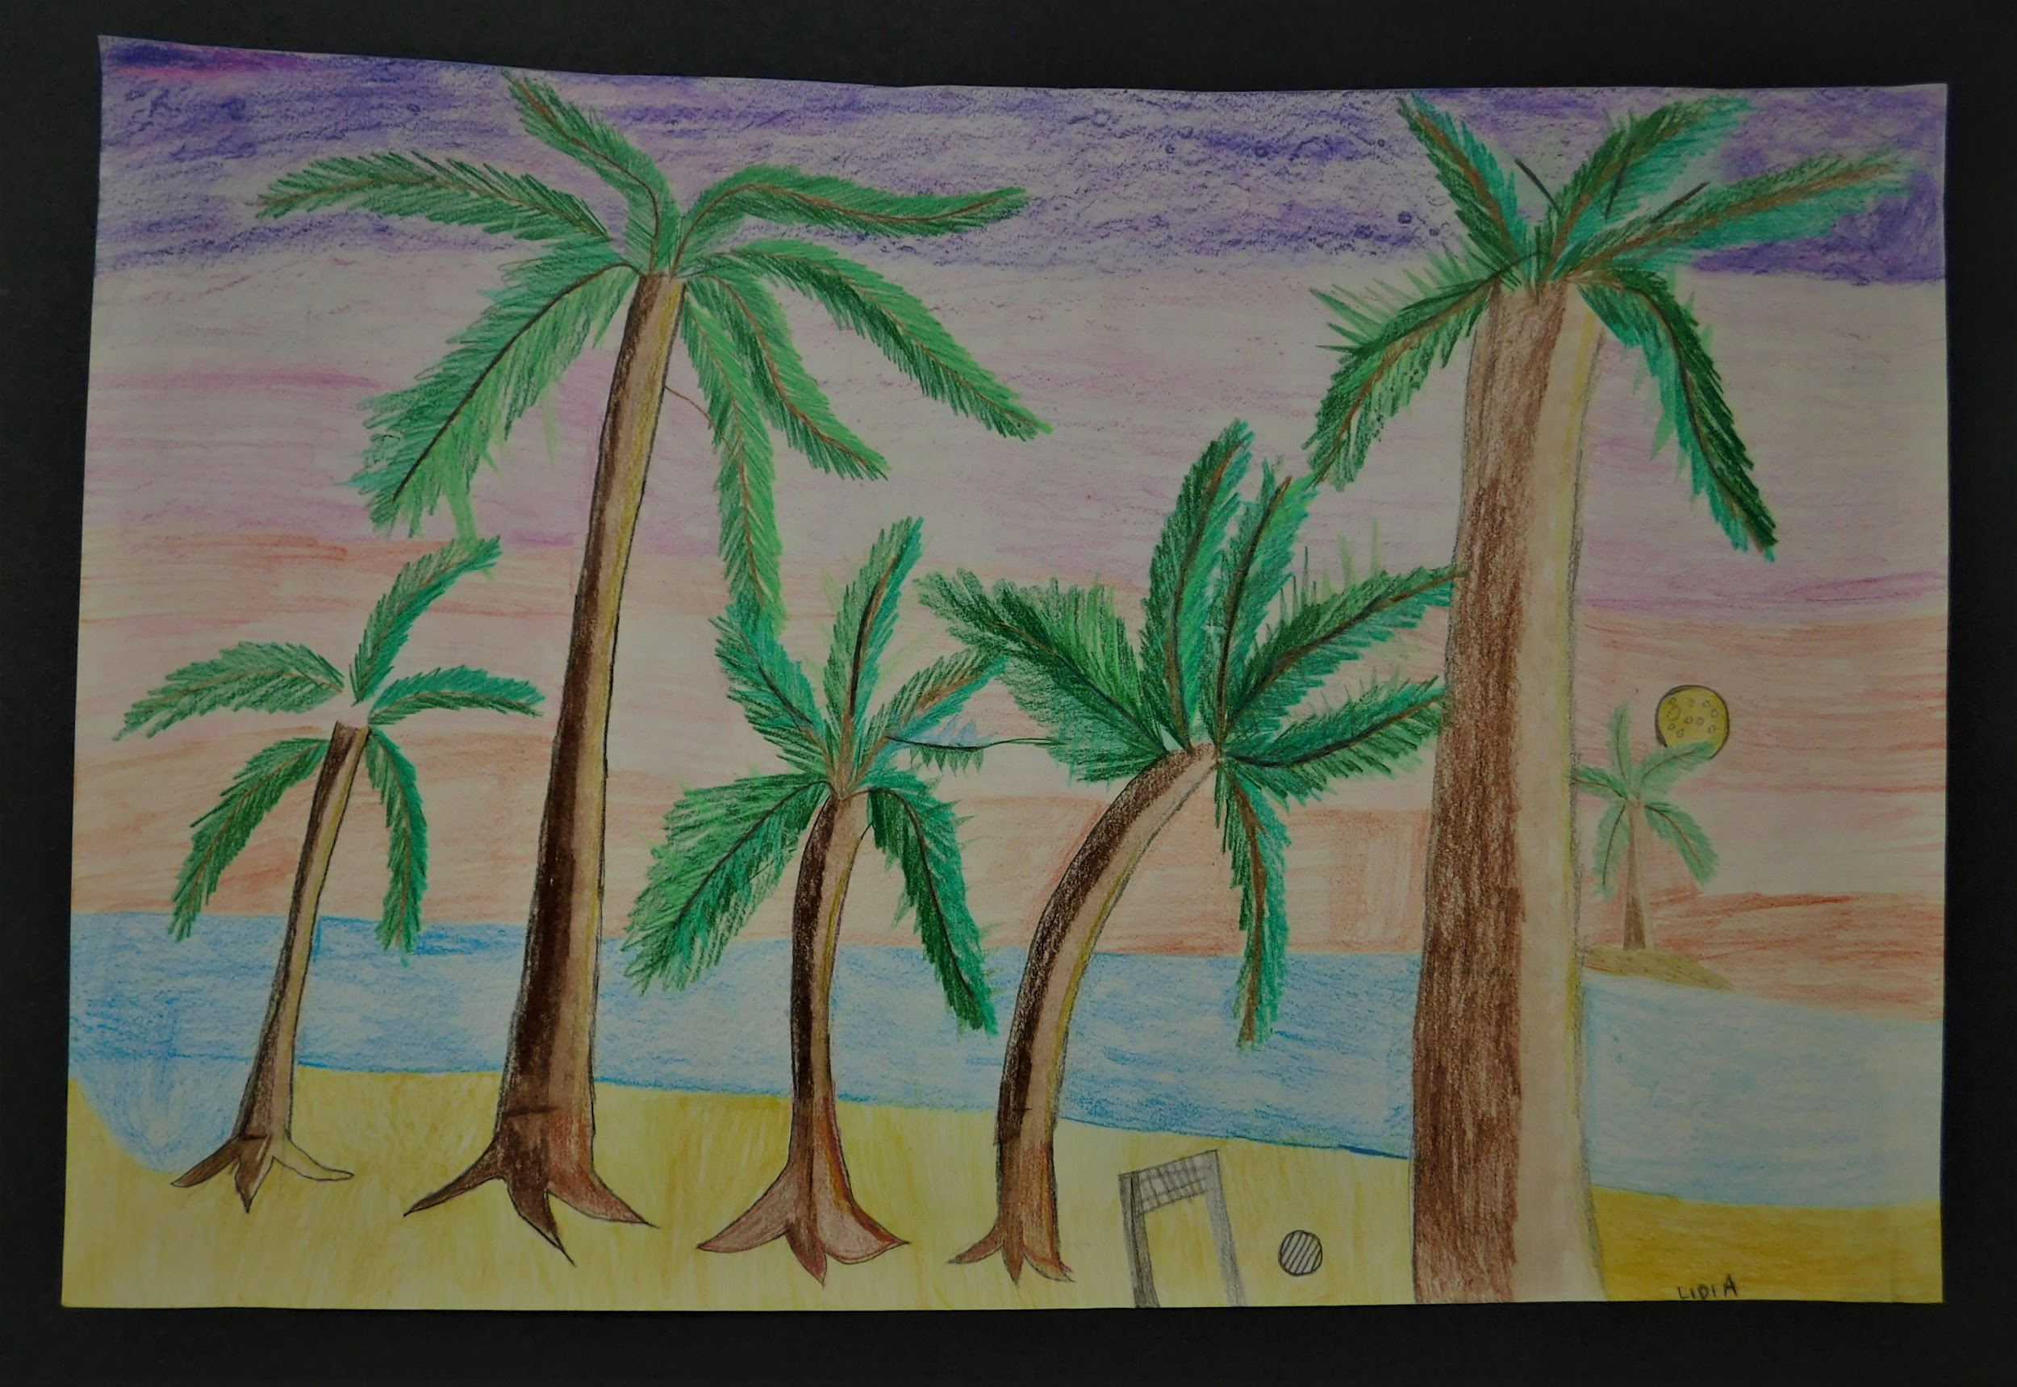
PALM BEACH IN MOONLIGHT
(Drawing: Lidia A. - 9th Grade)

Slide 7
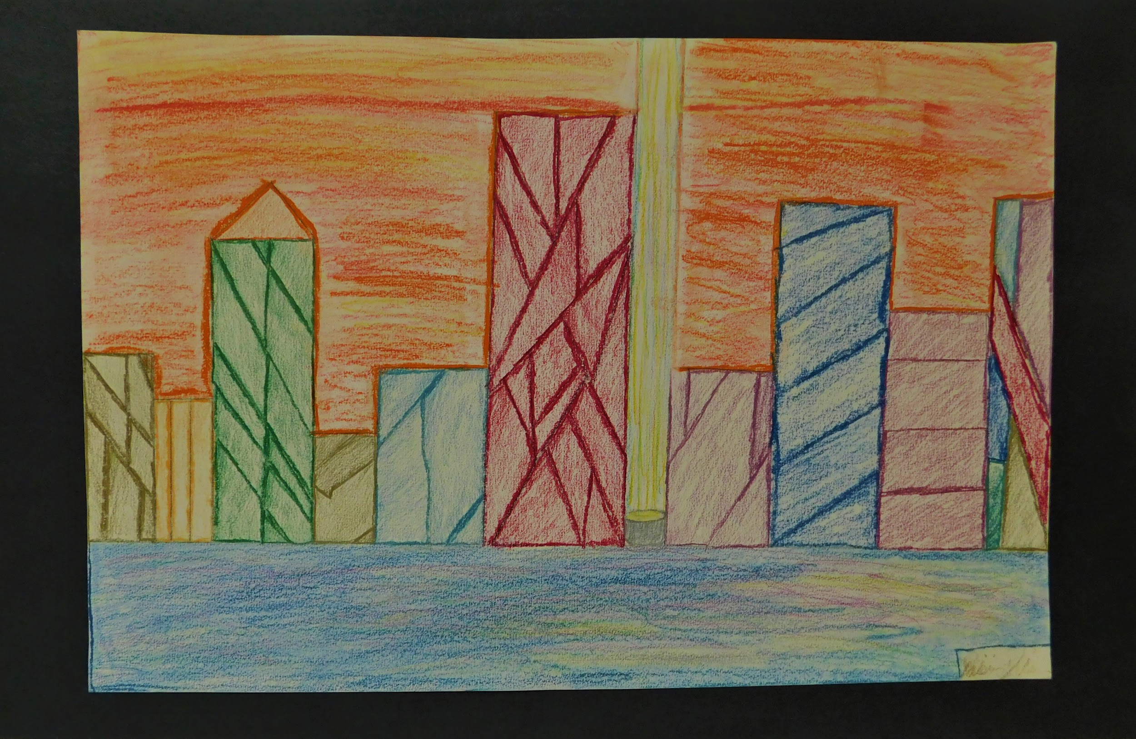
CITY SHORE SCAPE
(Drawing: Daishun D. - 10th Grade)

Slide 8
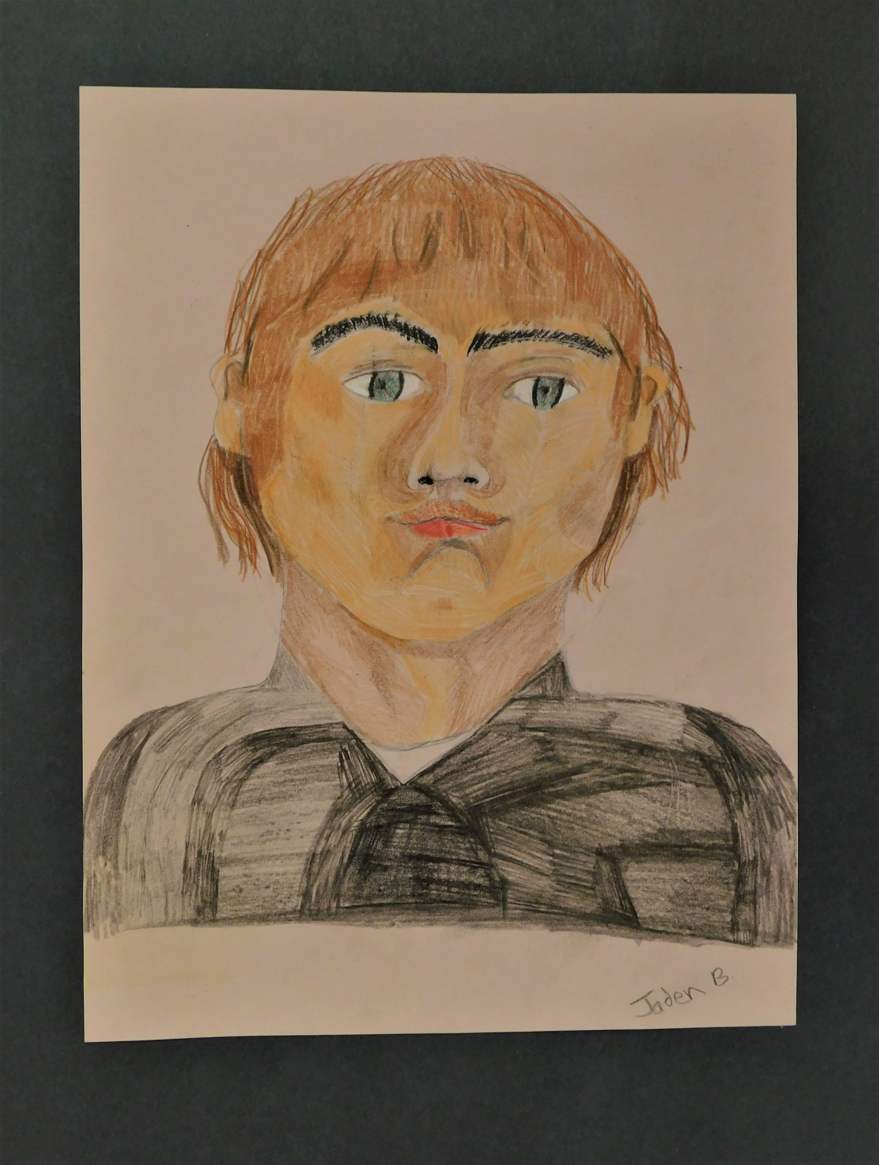
SELF PORTRAIT
(Drawing: Jaden B. - 11th Grade)

Slide 9
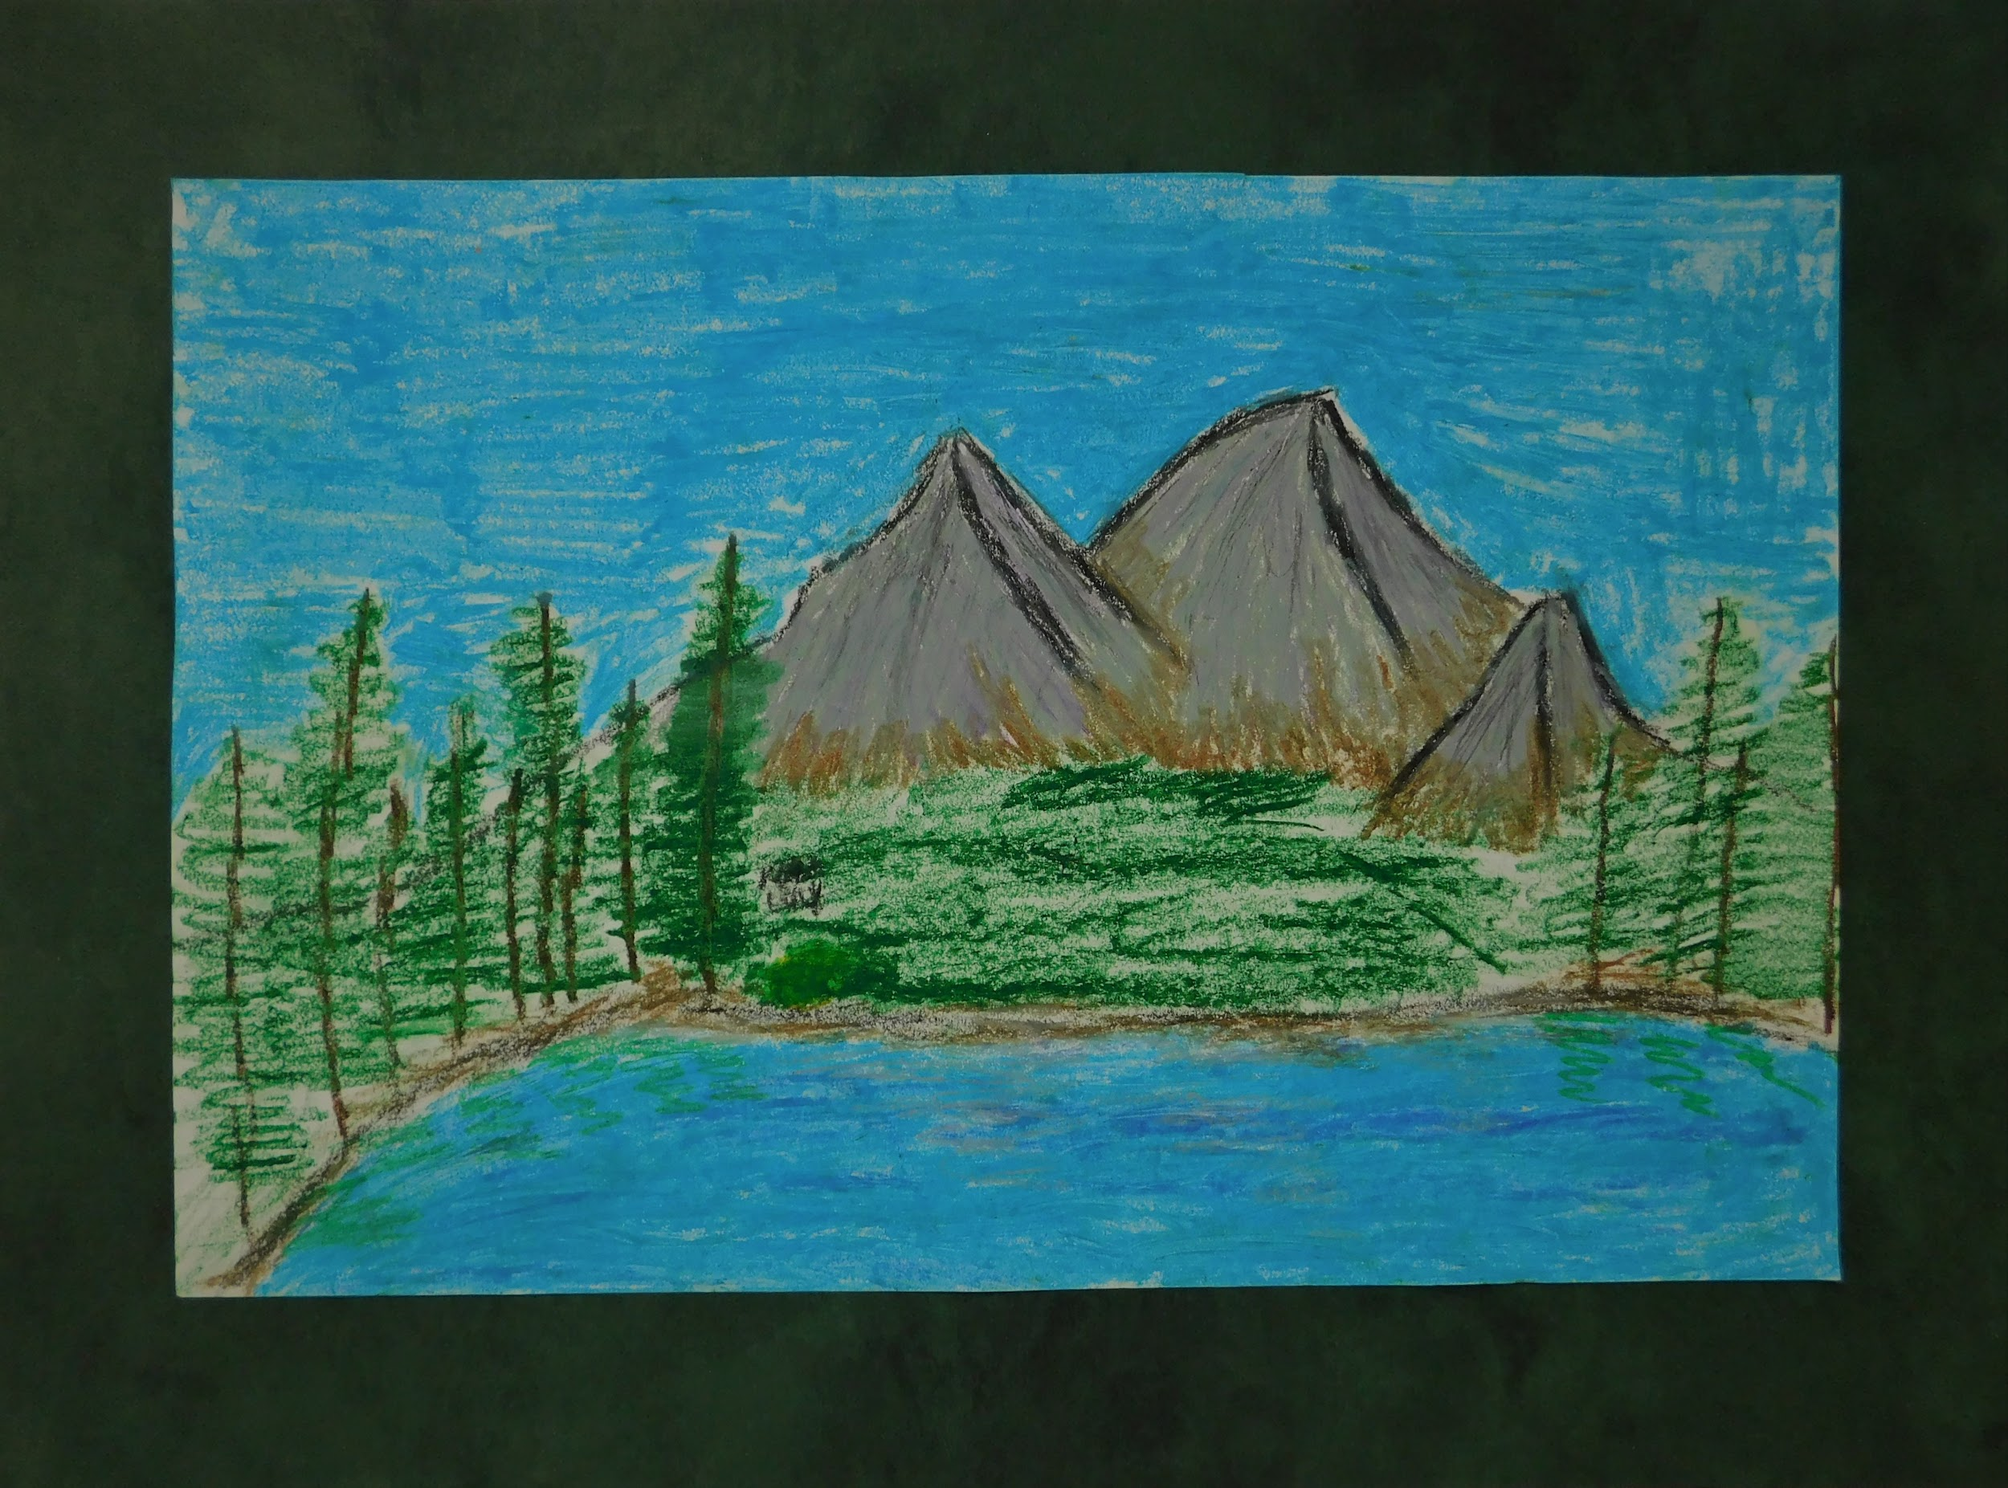
MOUNTAIN VIEW
(Drawing: Garrison V. - 7th Grade)

Slide 10
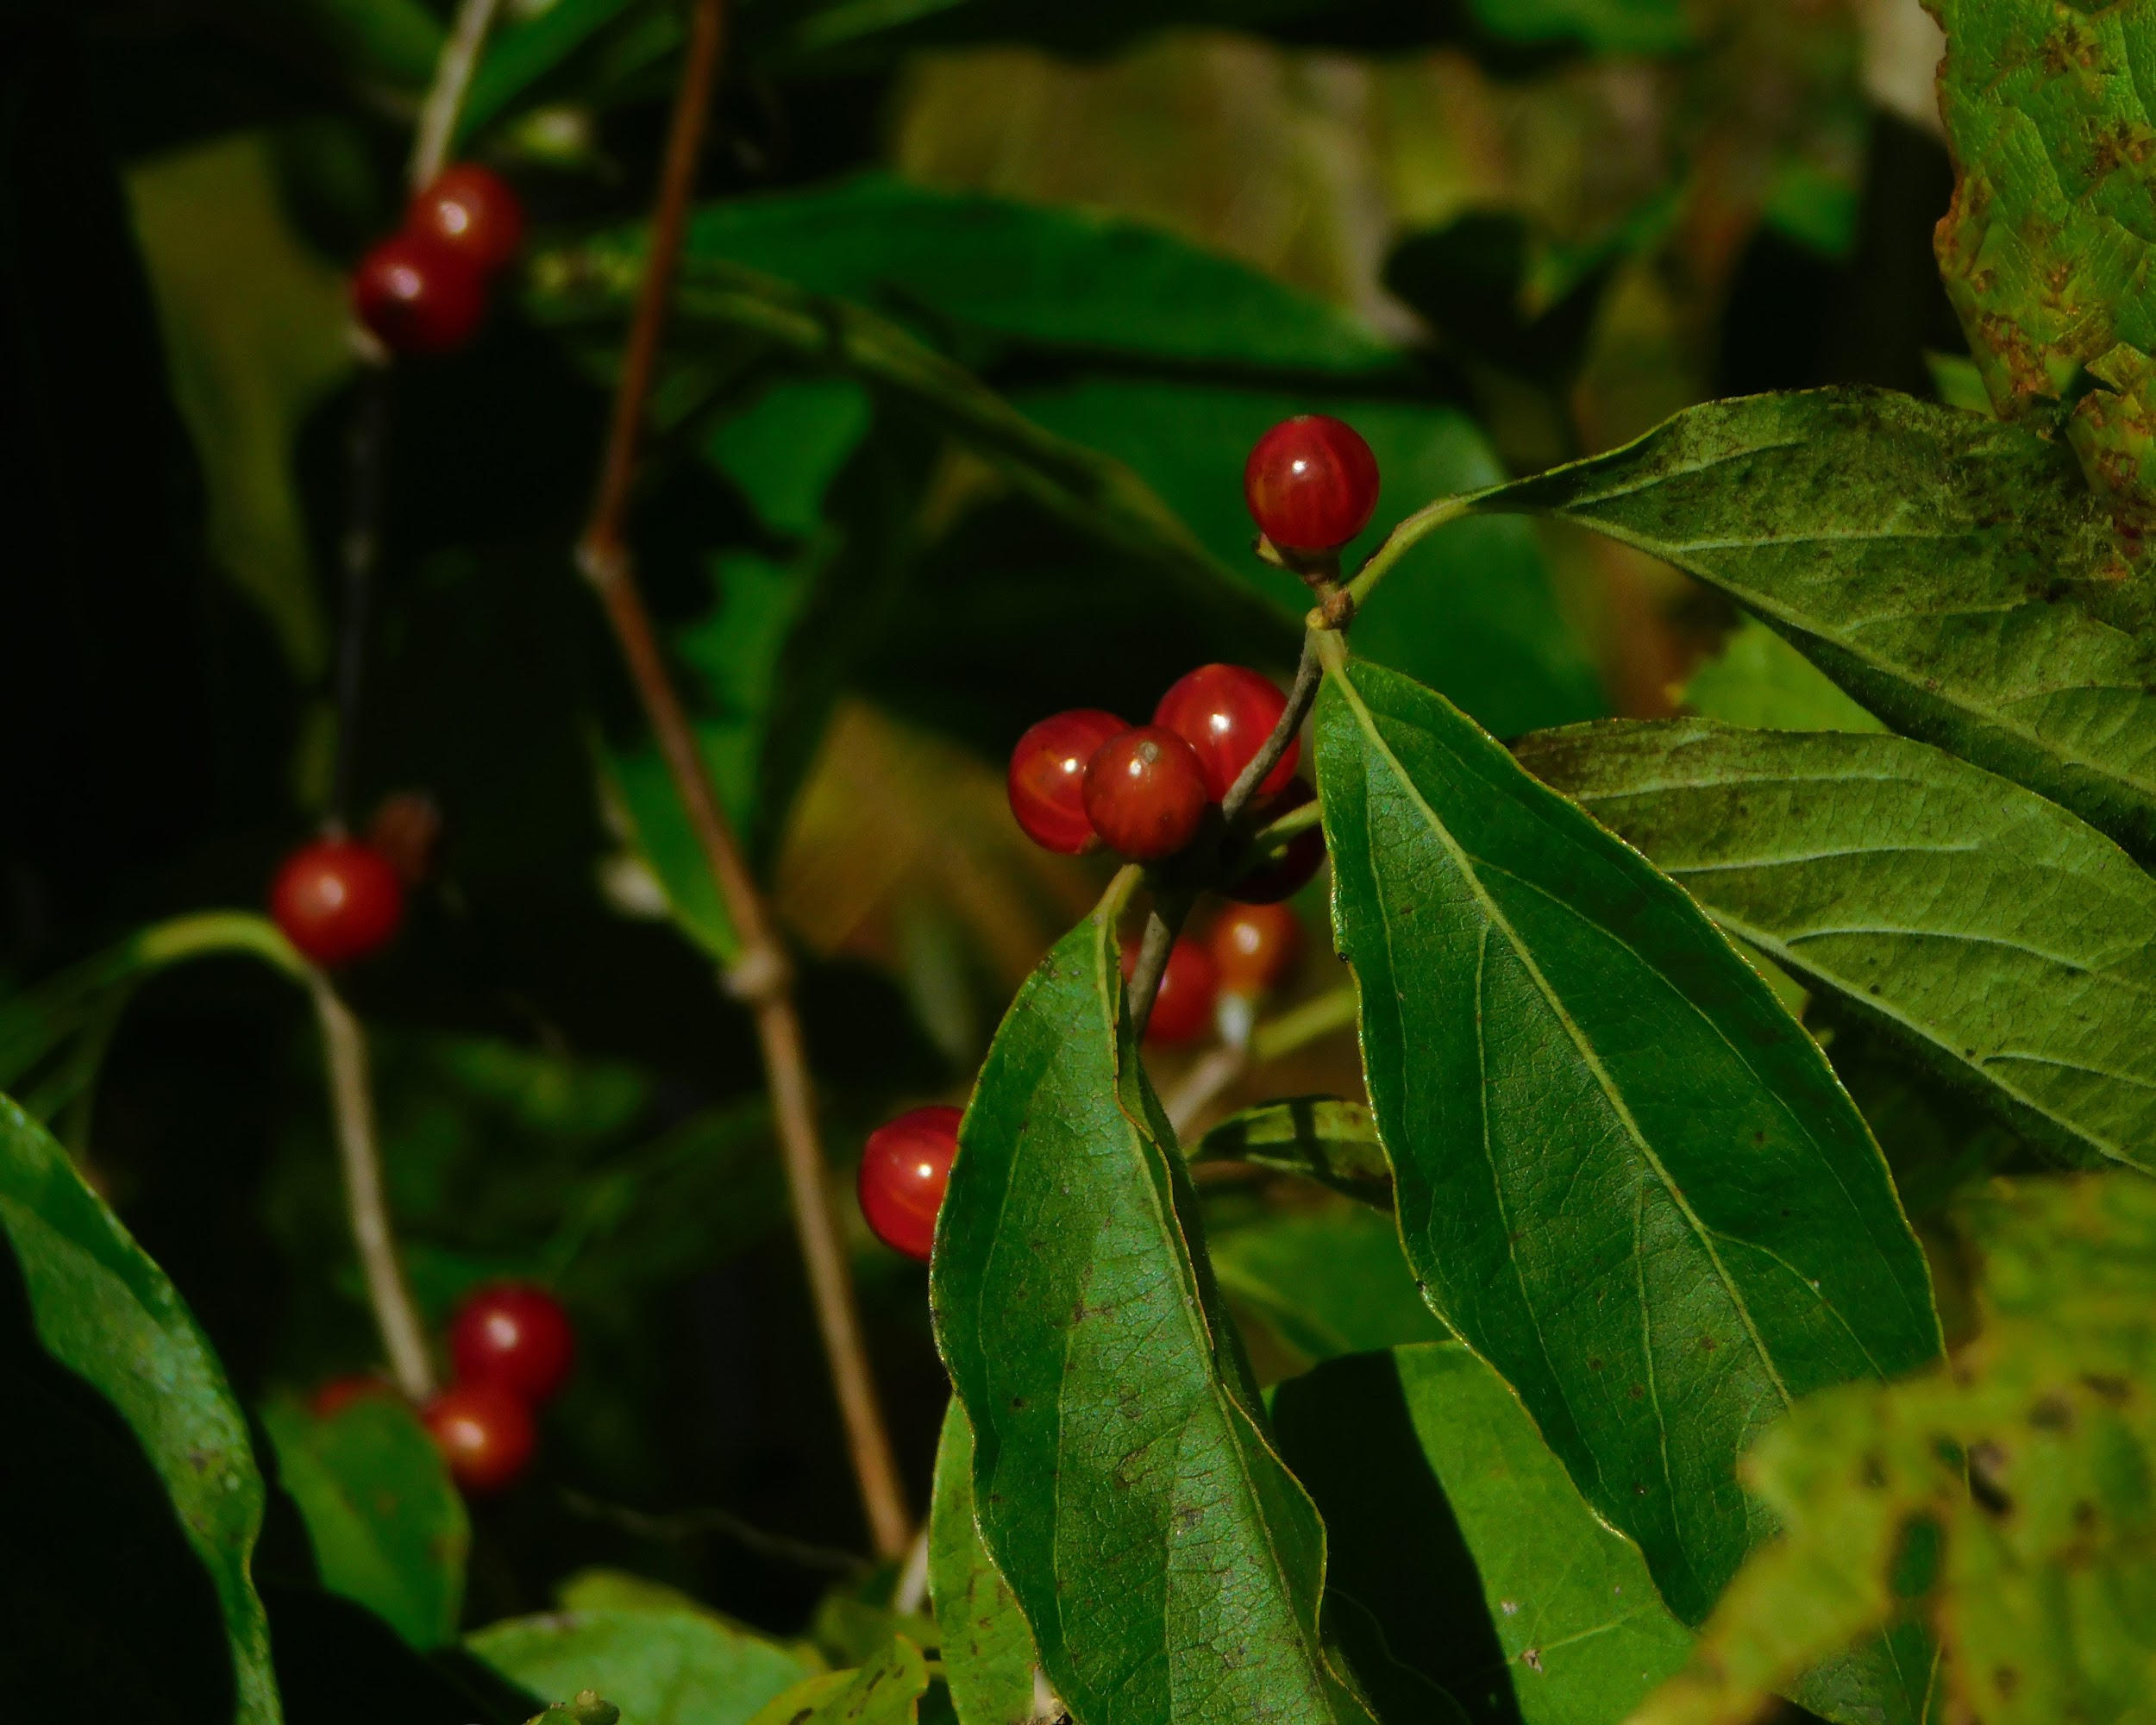
TEMPTATION
(Digital: Devin L. - 12th Grade)

Slide 11
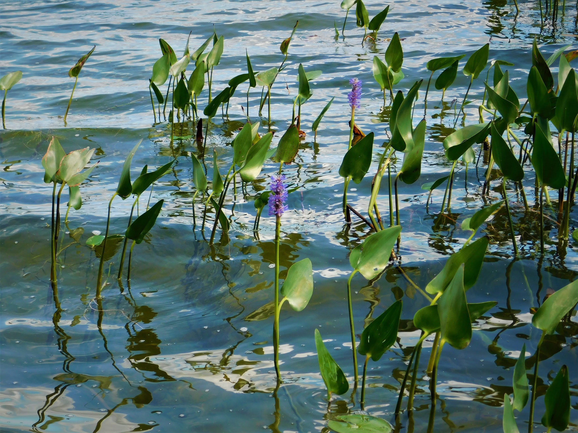
LAPPING LILLY PADS
(Digital: Lidia A. - 9th Grade)

Slide 12
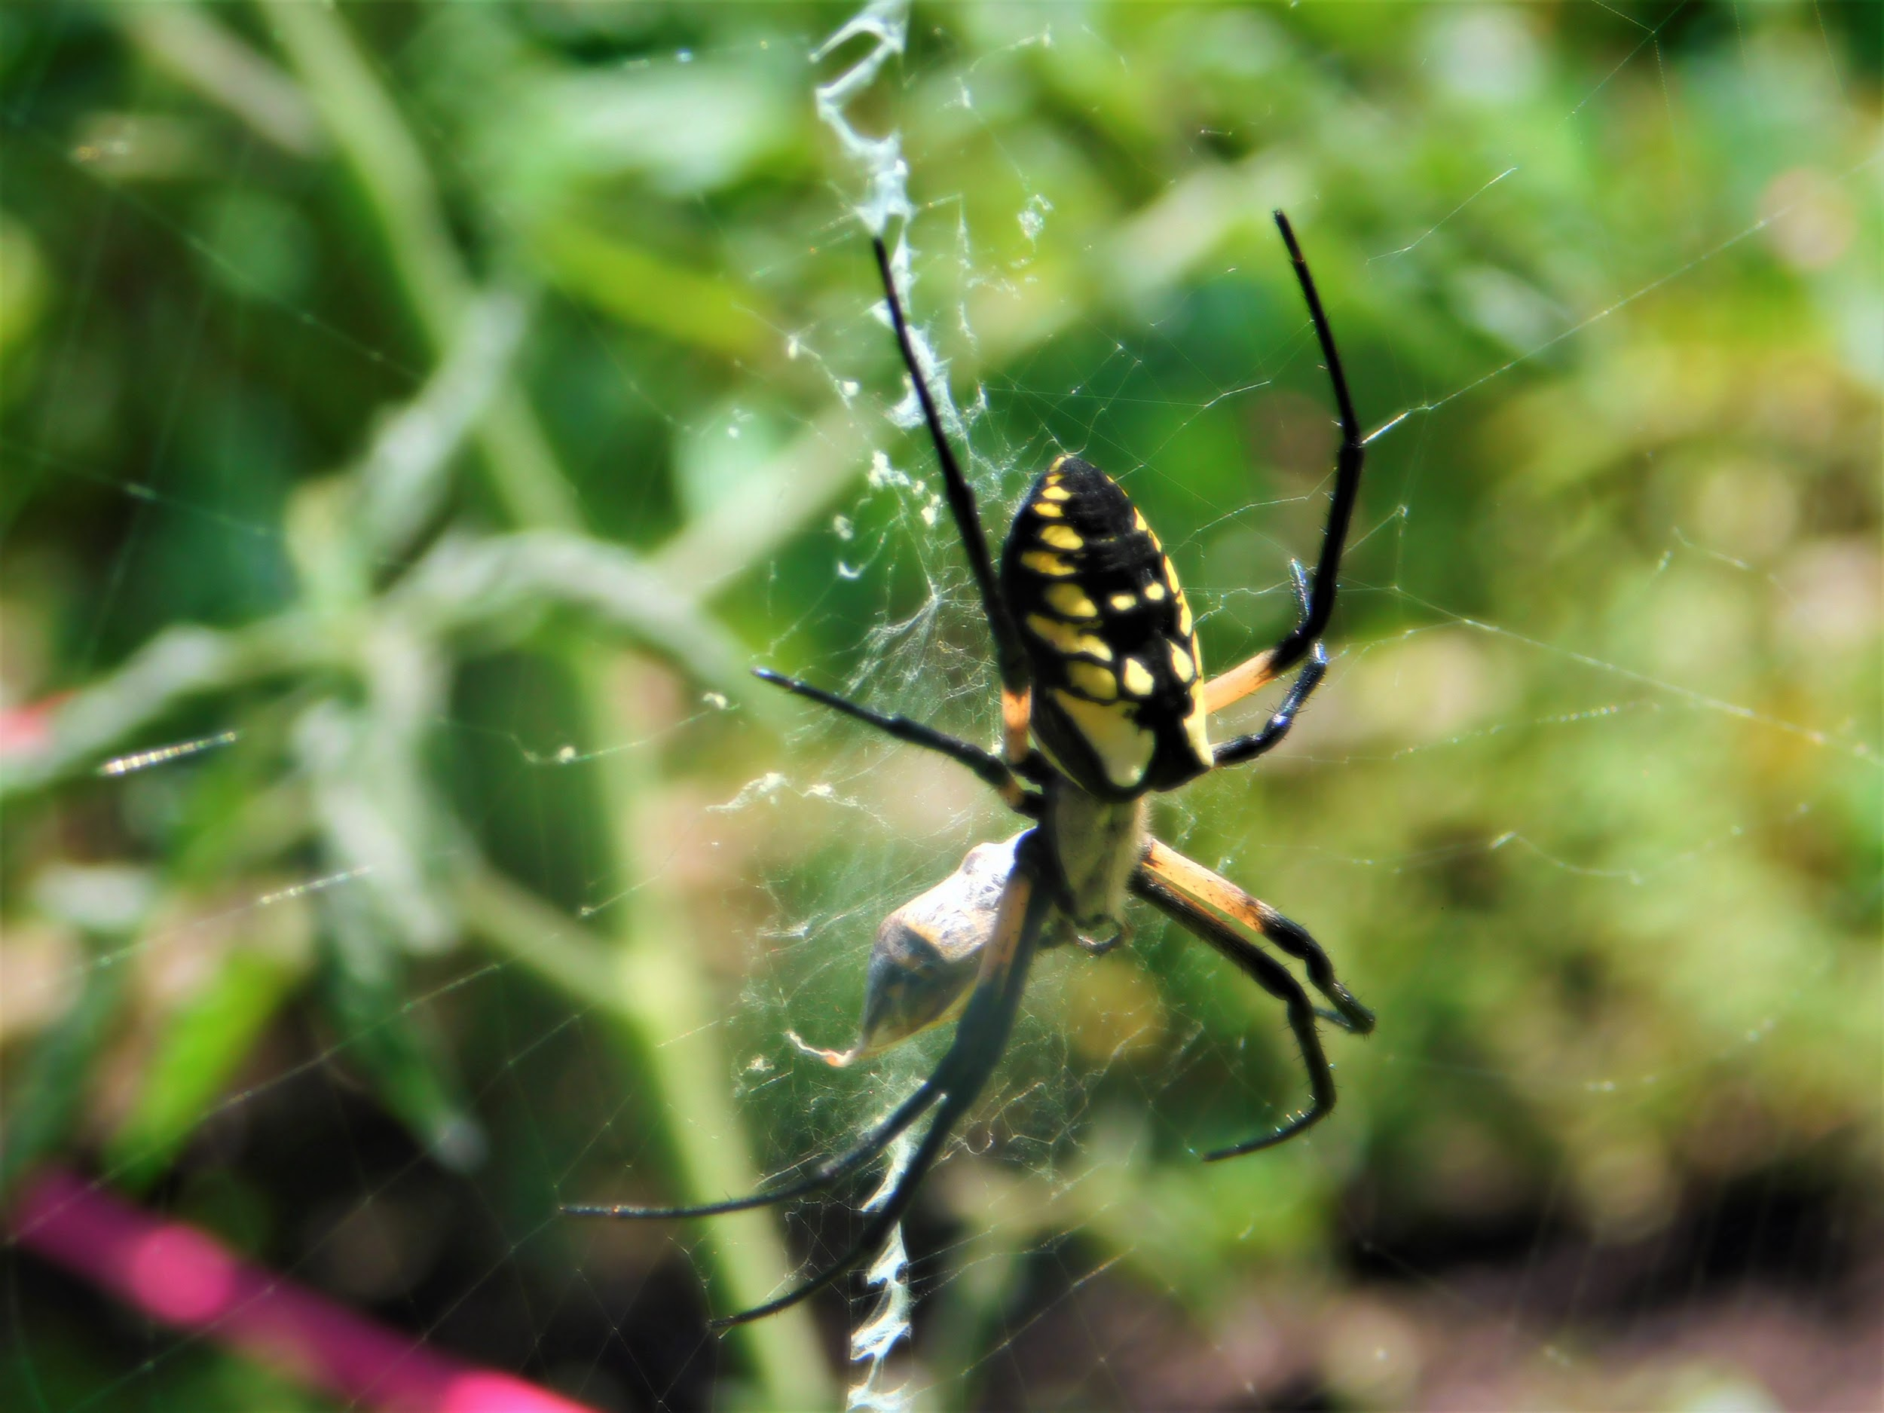
TRAPEZE ARTIST
(Digital: Daeveonn W. - 8th Grade)

Slide 13
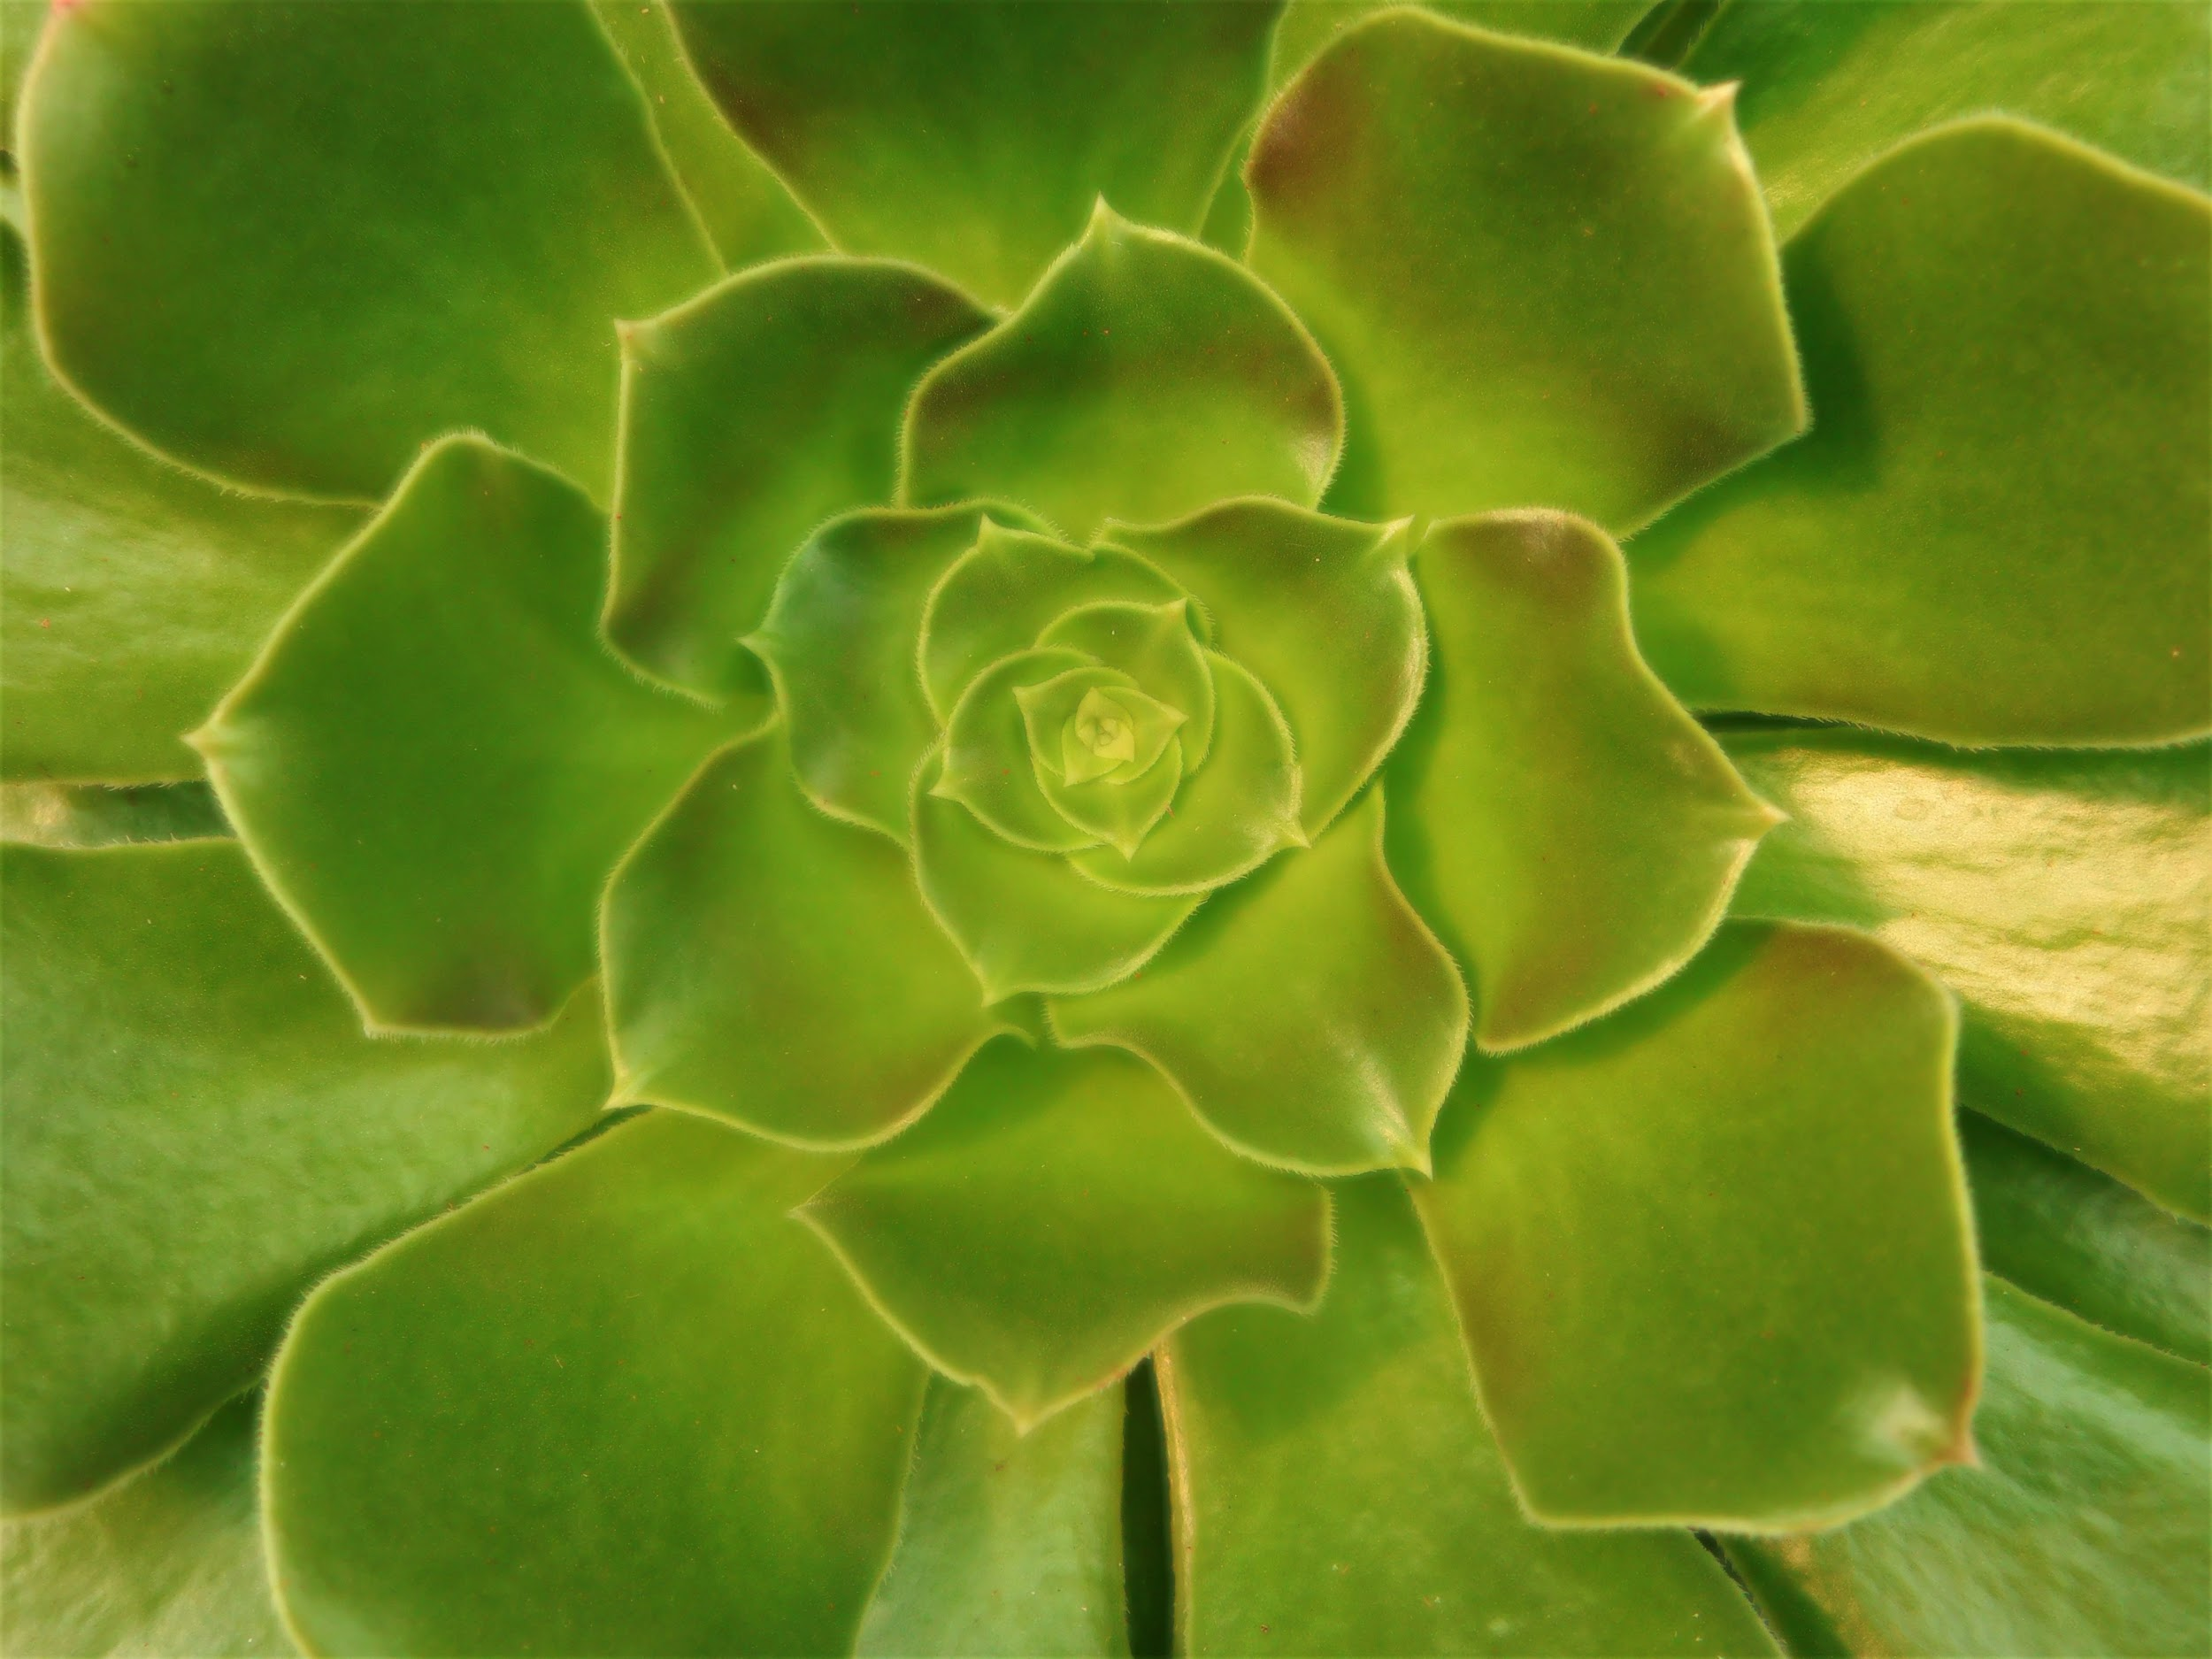
INVITATION
(Digital: Hannah S. - 10th Grade)

Slide 14
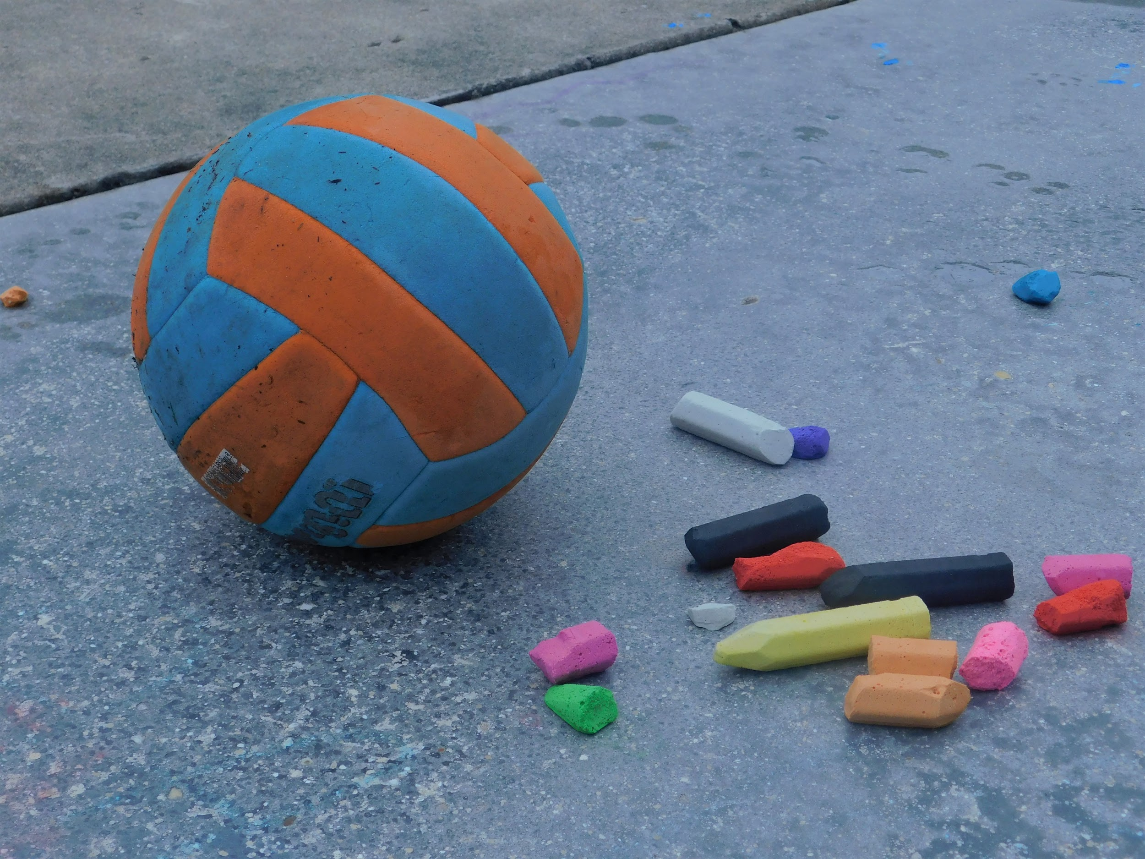
ON YOUR MARK
(Digital: Jasmine S. - 10th Grade)

Slide 15
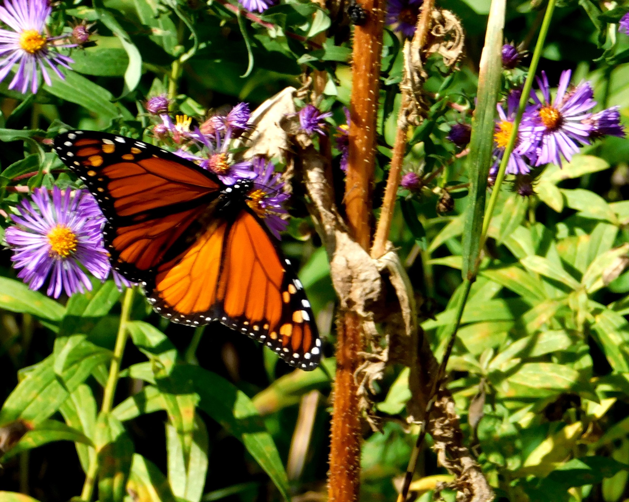
SO CLOSE
(Digital: Manuel - 10th Grade)

Slide 16
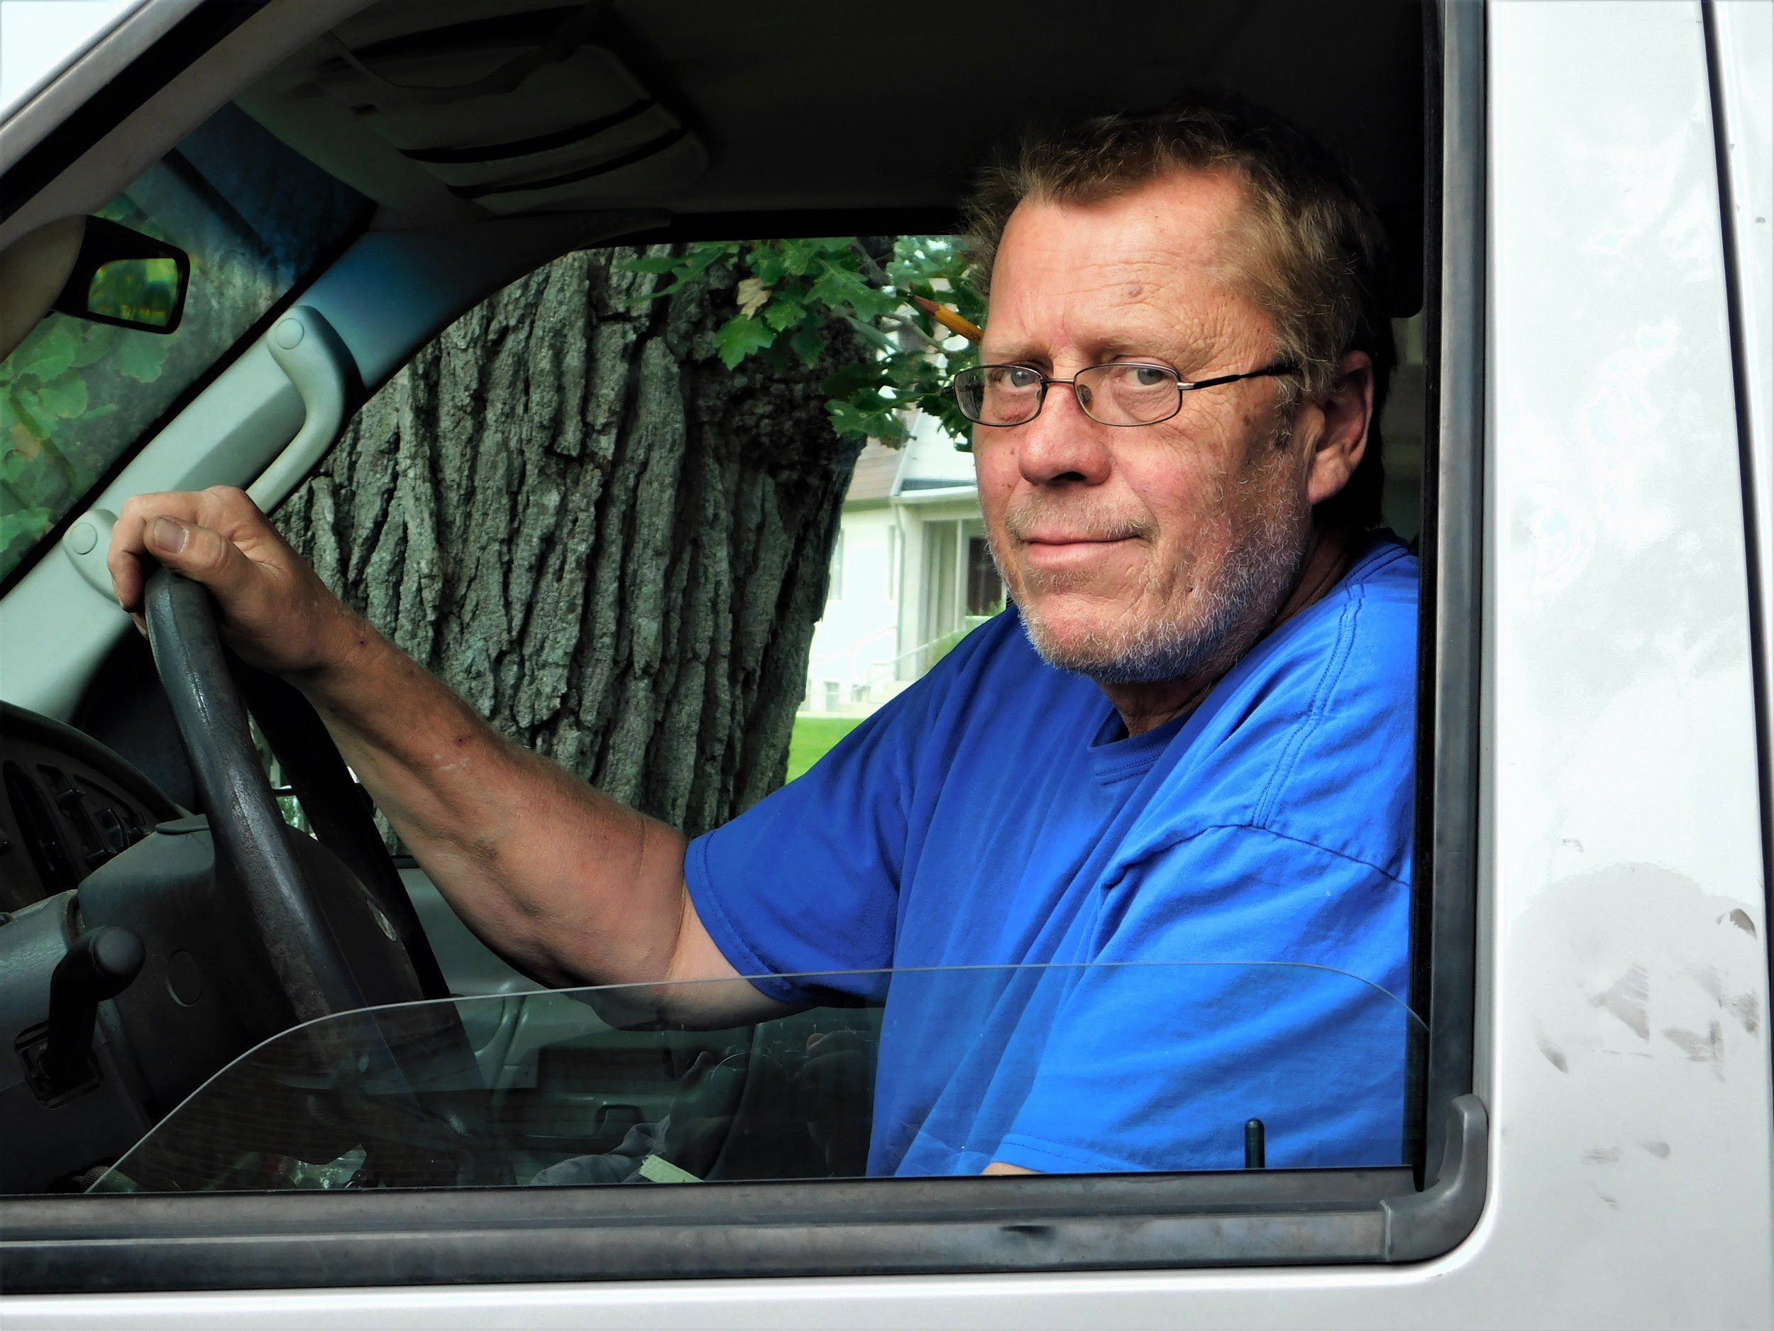
WEATHERED
(Digital: Brandon D. - 10th Grade)

Slide 17
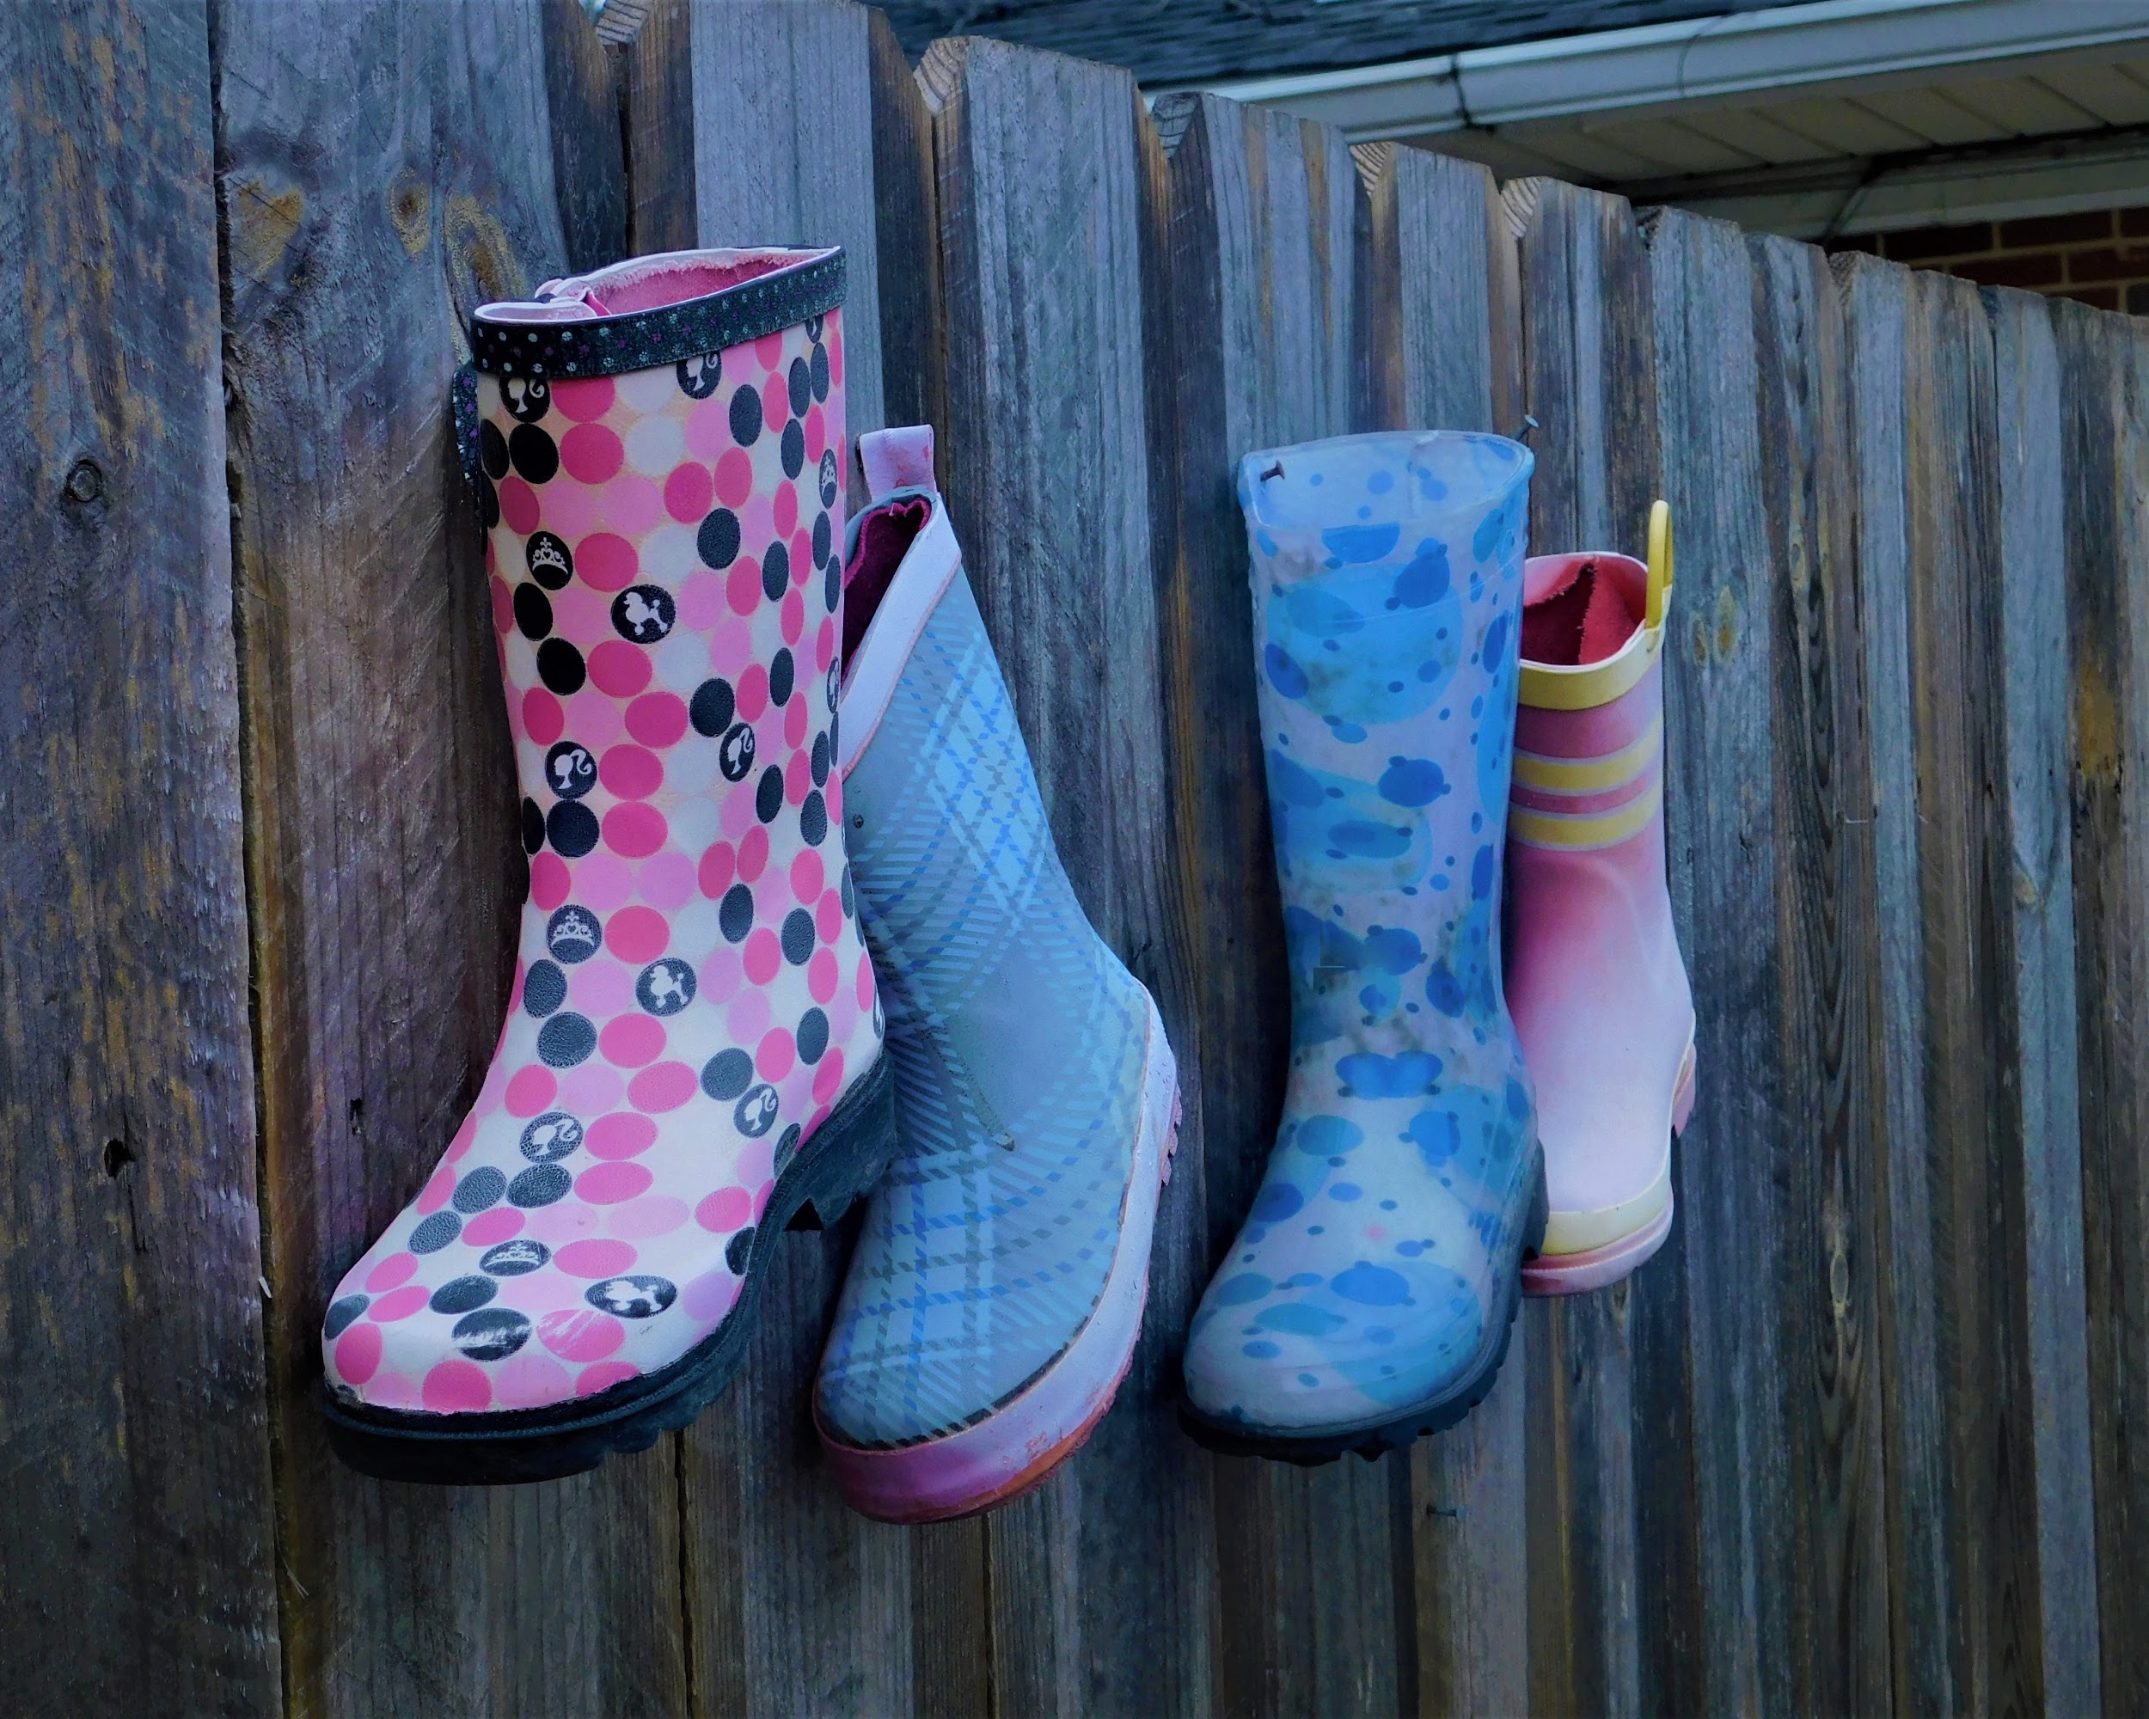
FORWARD MARCH
(Digital: Raven J. - 11th Grade)

Slide 18
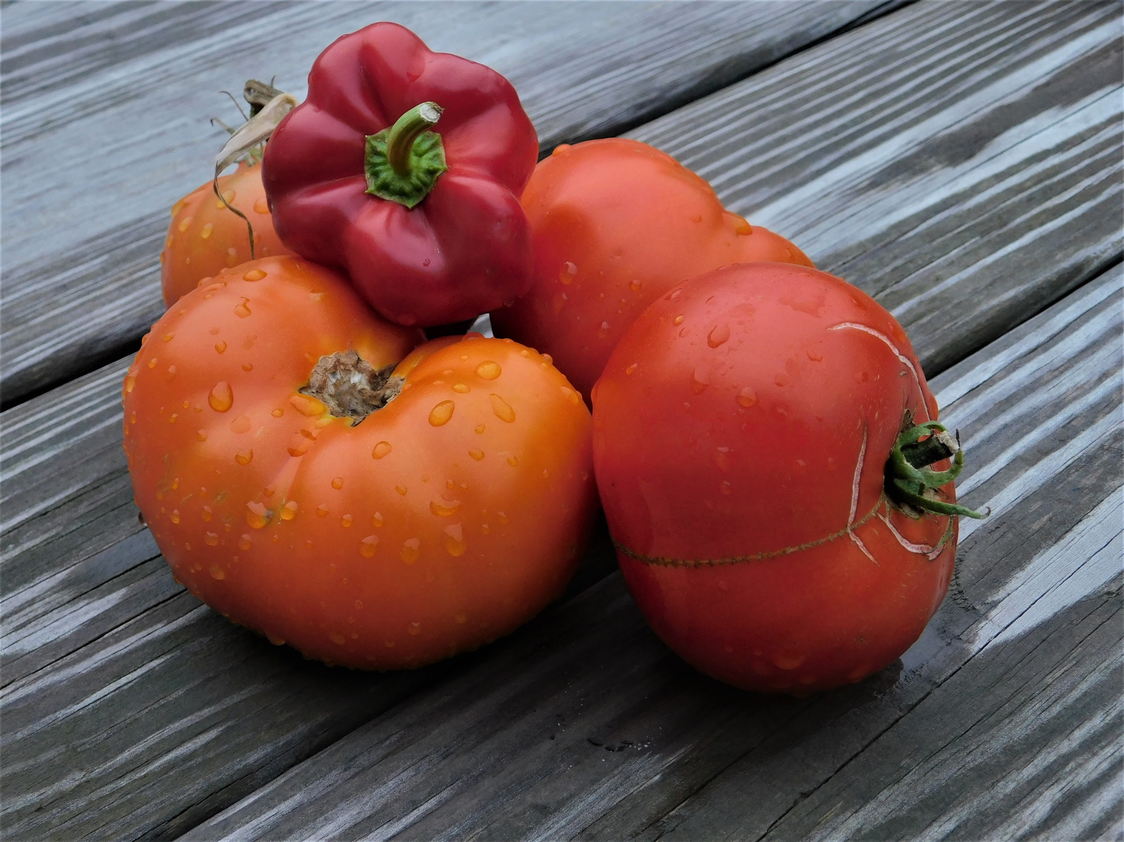
LUSCIOUS REDS
(Digital: Raven - 11th Grade)

Slide 19
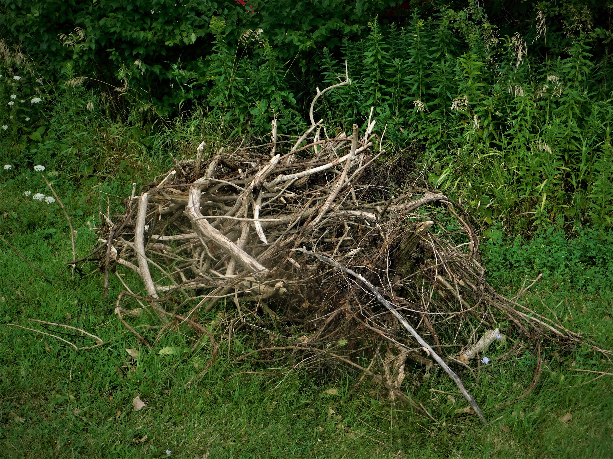
DISCARDED BEAUTY
(Digital: Marquavion K. - 11th Grade)

Slide 20
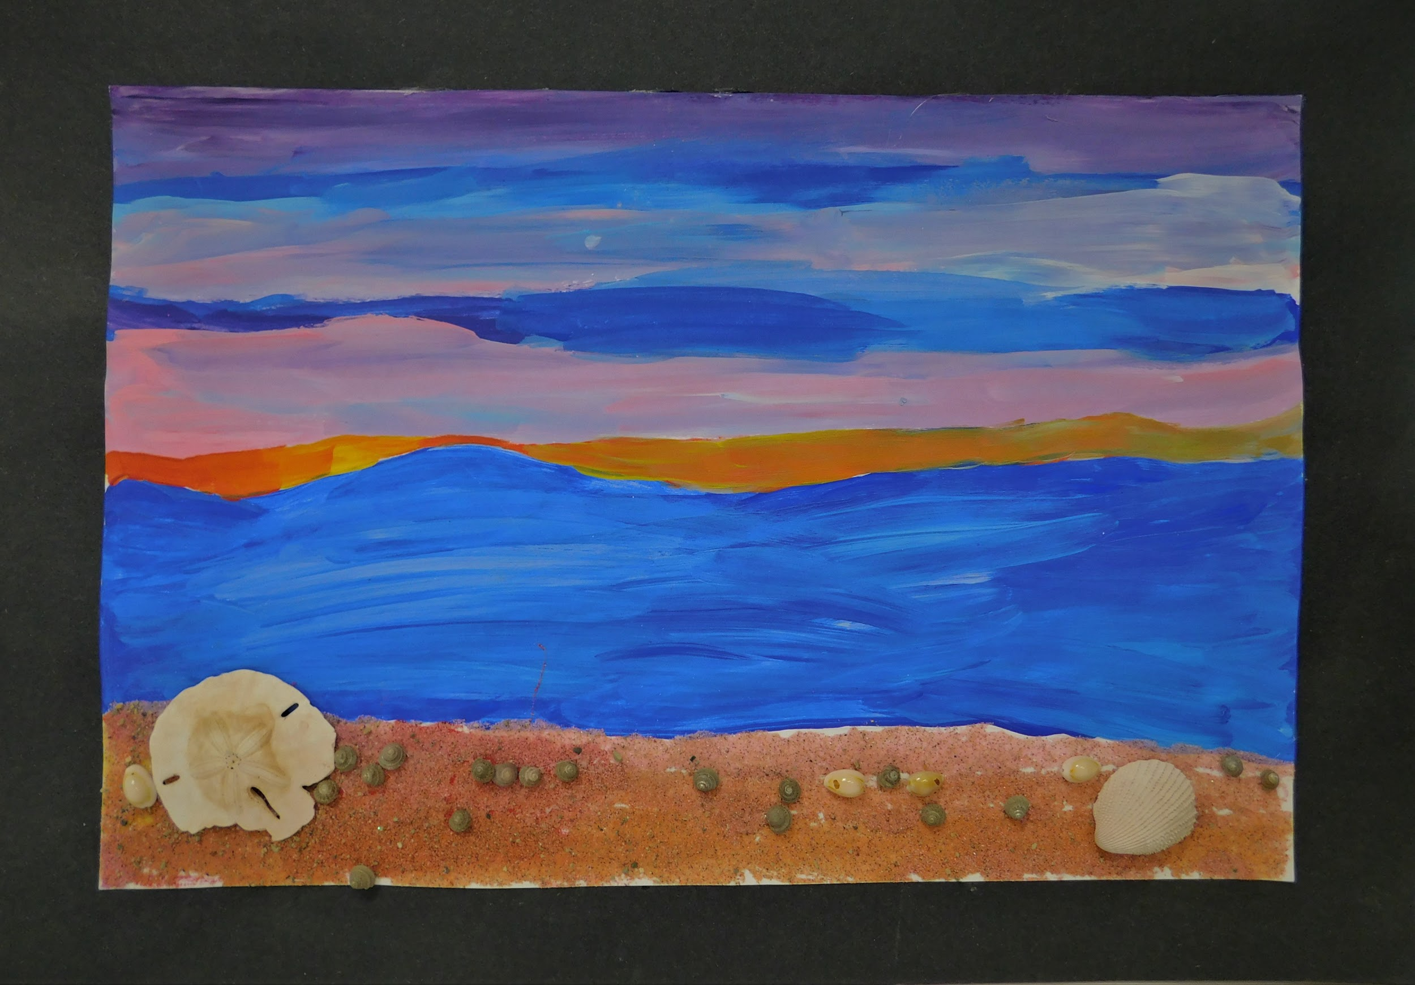
SANDY SHORE AT SUNSET
(Multi-Media: Markeishea J. - 9th Grade)

Slide 21
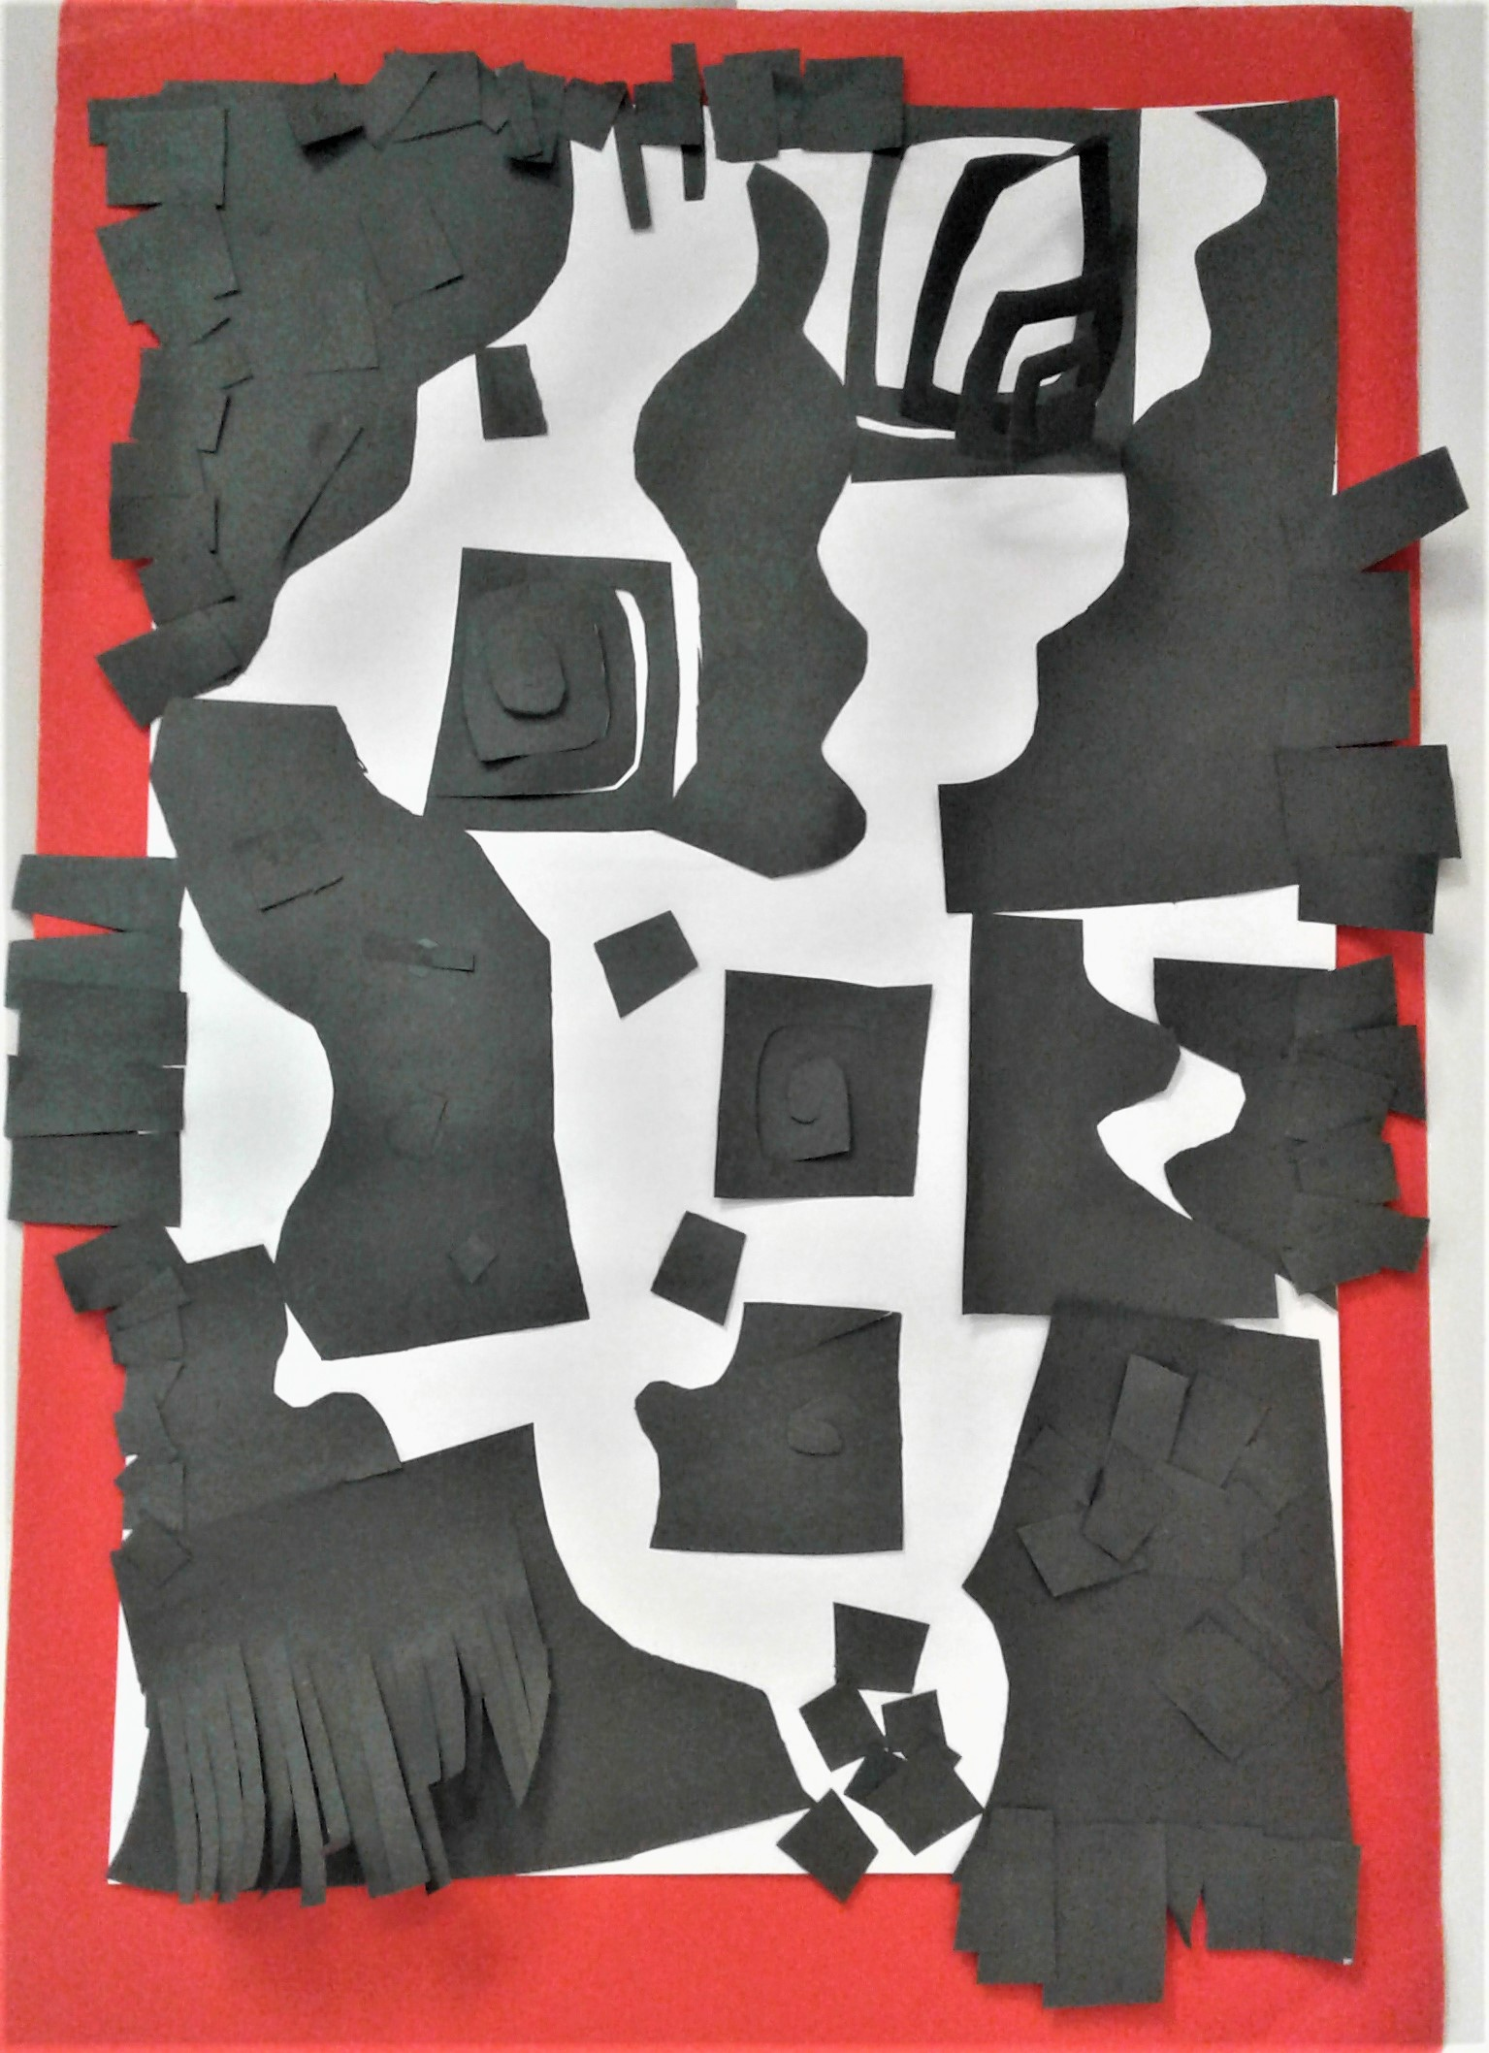
ALL THAT JAZZ
(Multi-Media: JaNae R. - 10th Grade)

Slide 22
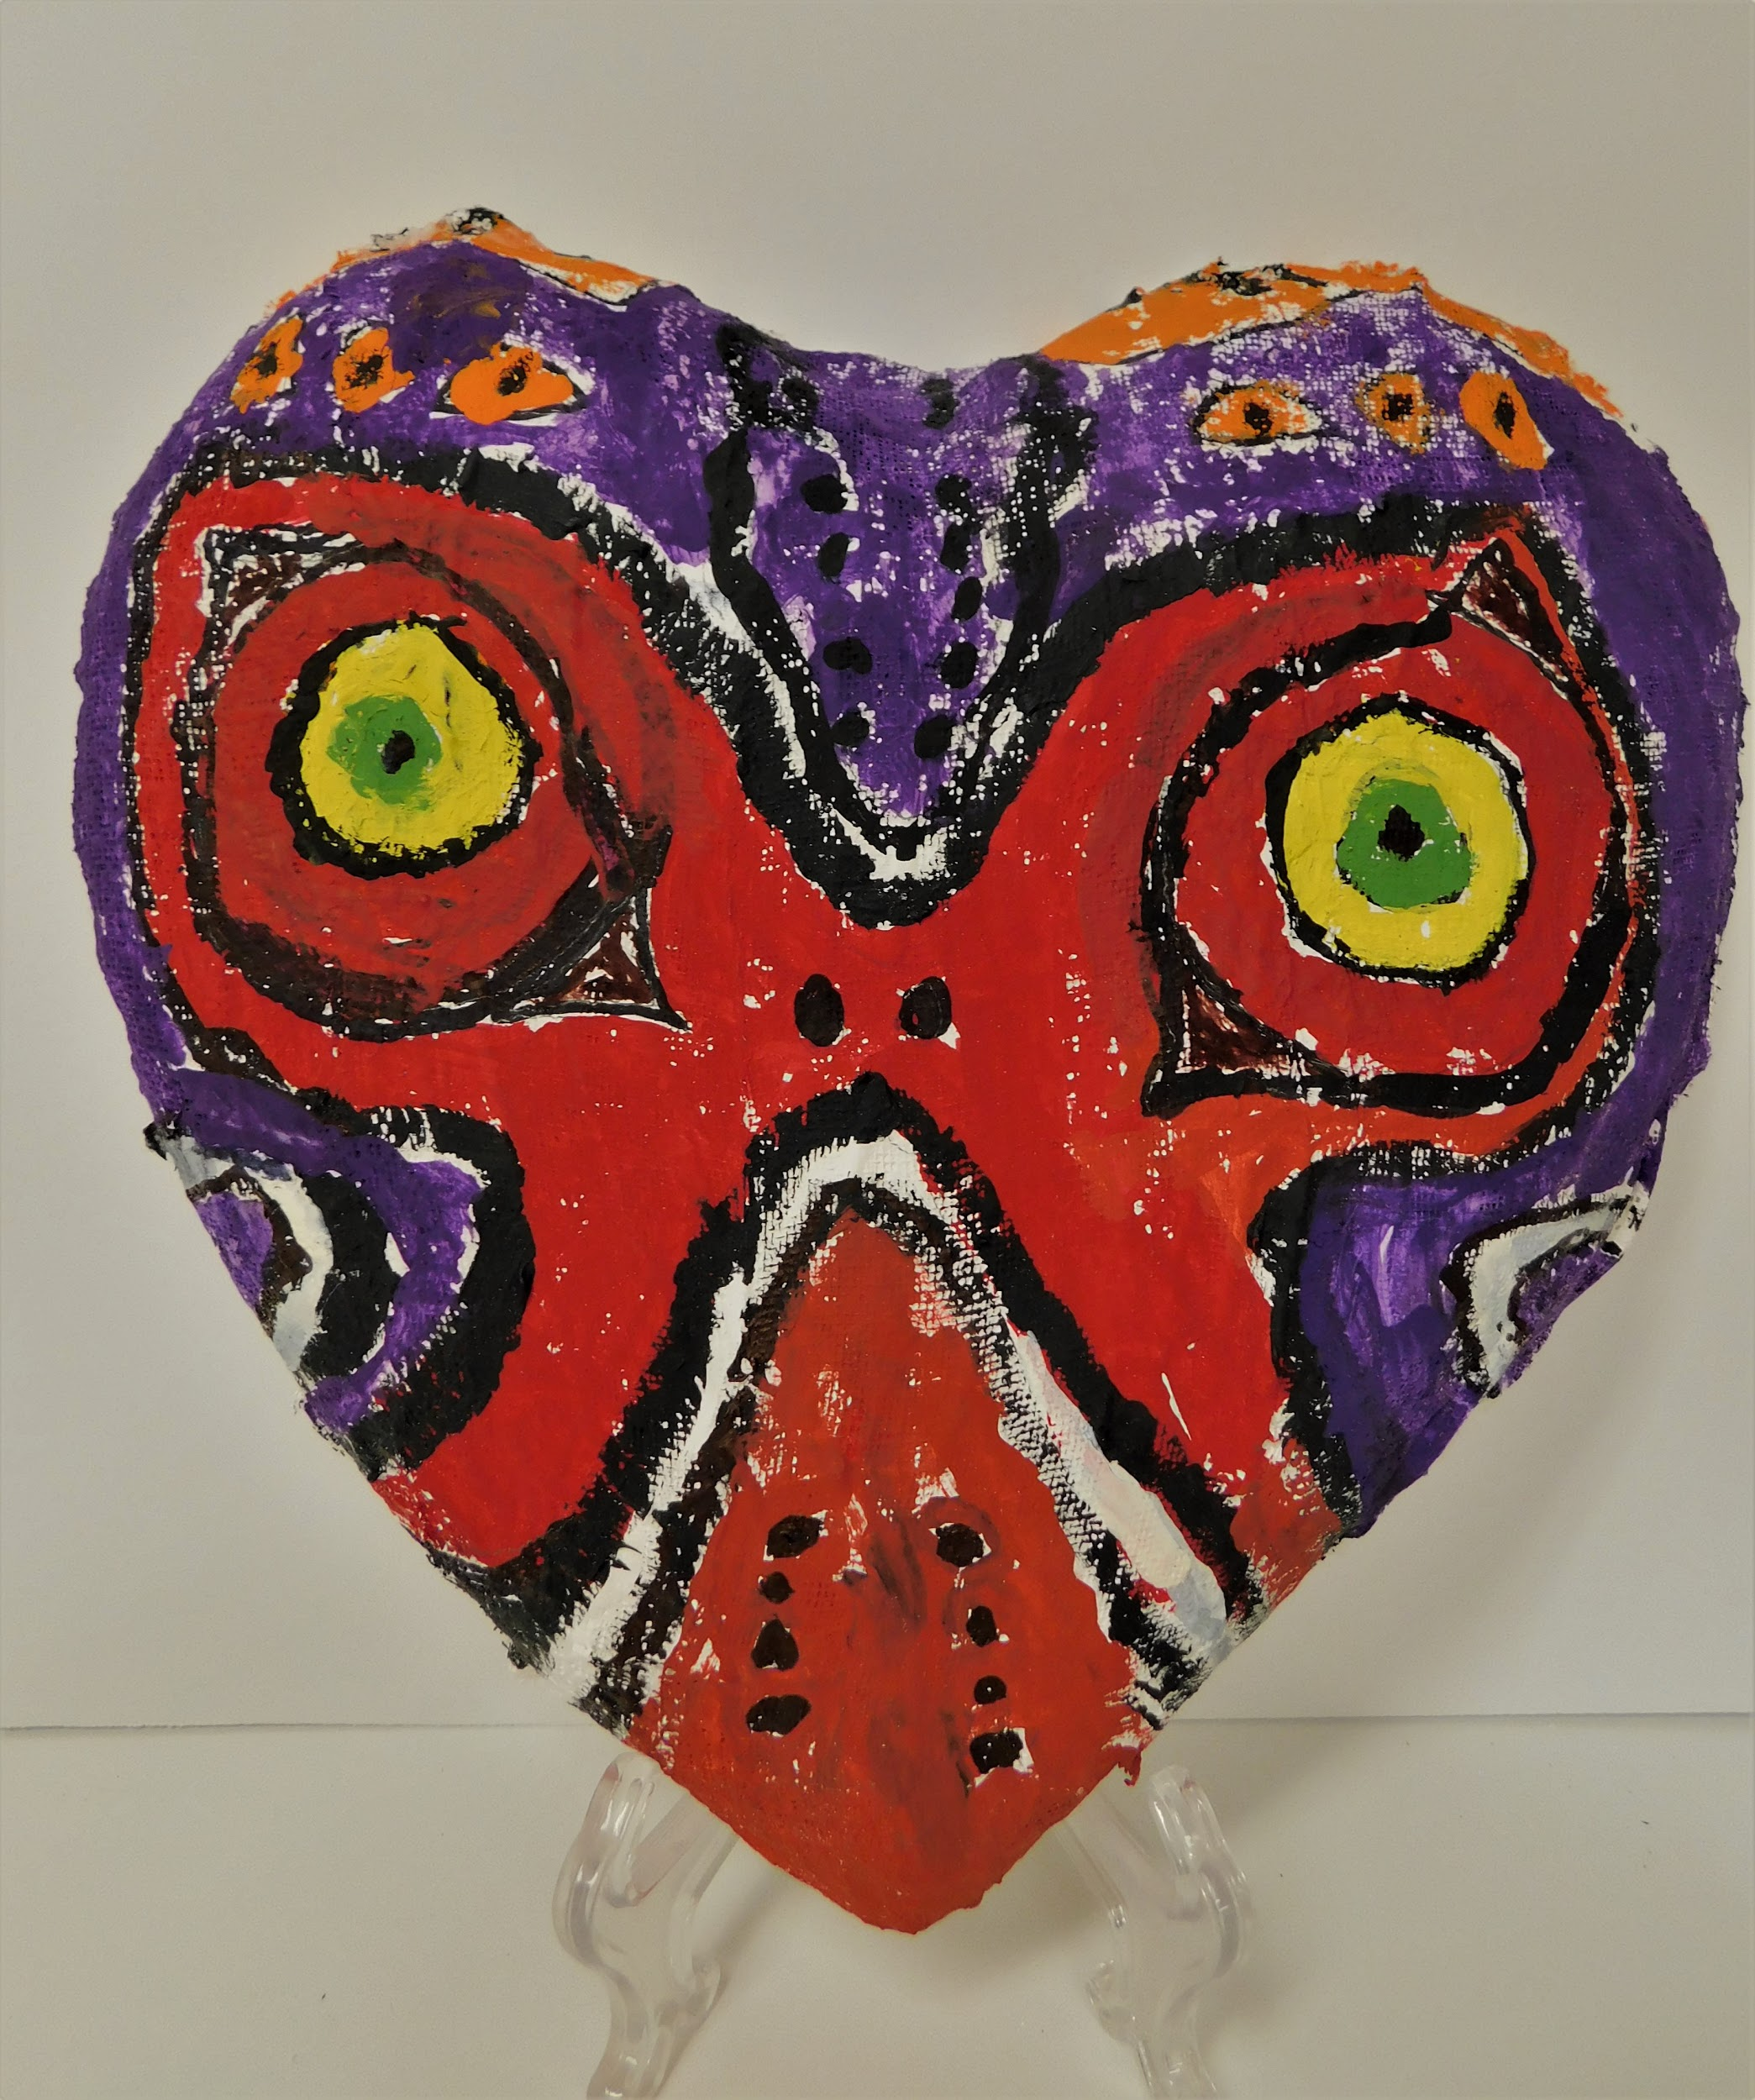
MAJORA’S MASK
(Sculpture: Daniel M.L. - 5th Grade)

Slide 23
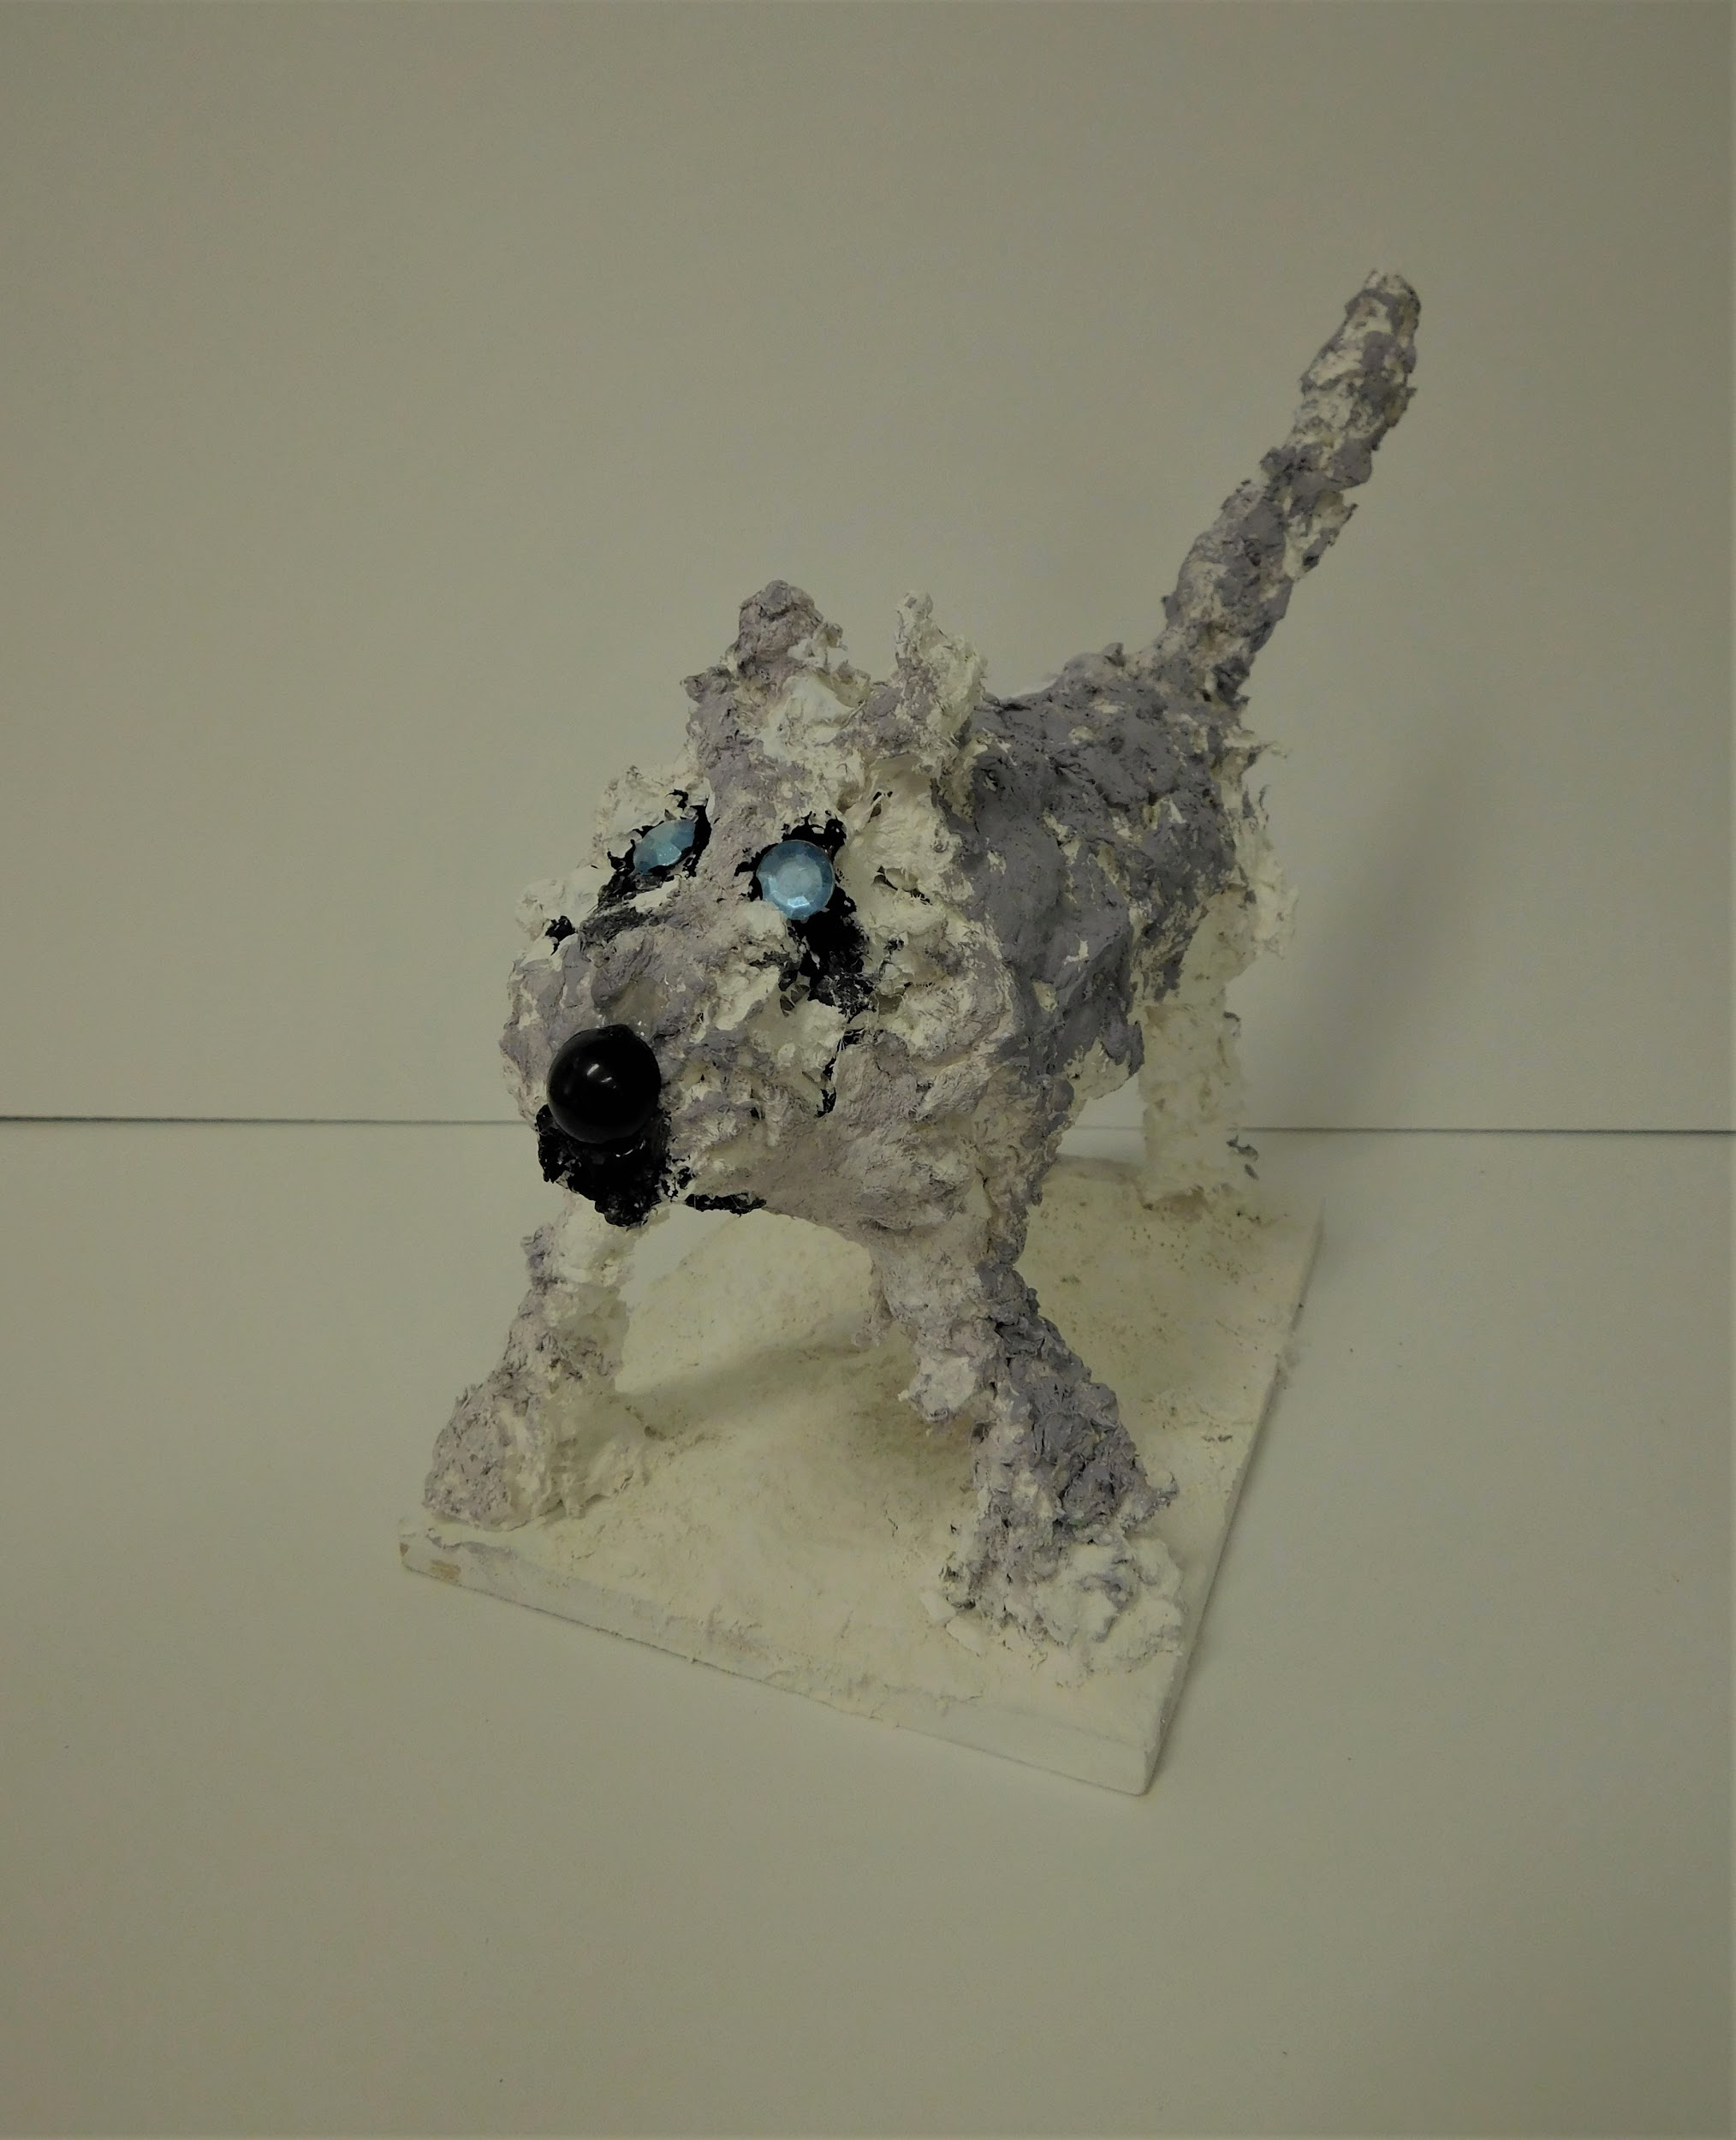
ARTIC WOLF
(Sculpture: Hannah P. - 7th Grade)

Slide 24
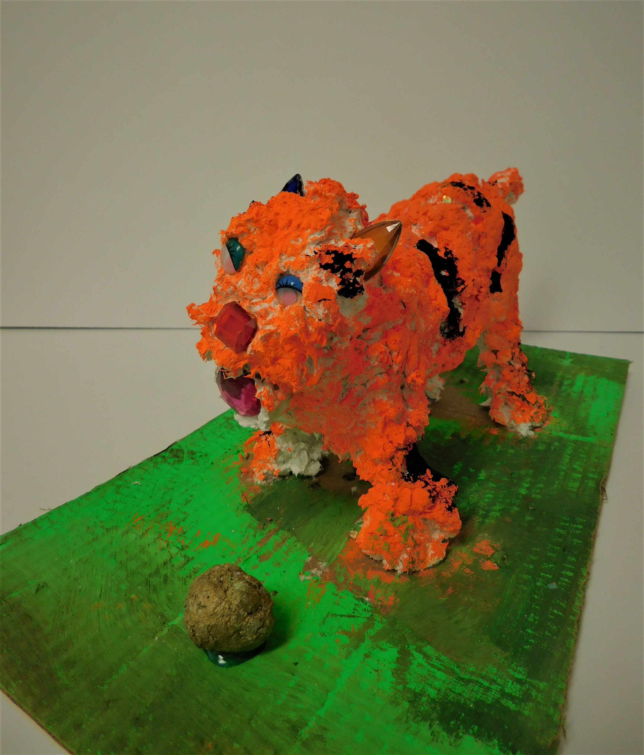
FIESTY KITTEN
(Sculpture: Iyanna B. - 8th Grade)

Slide 25
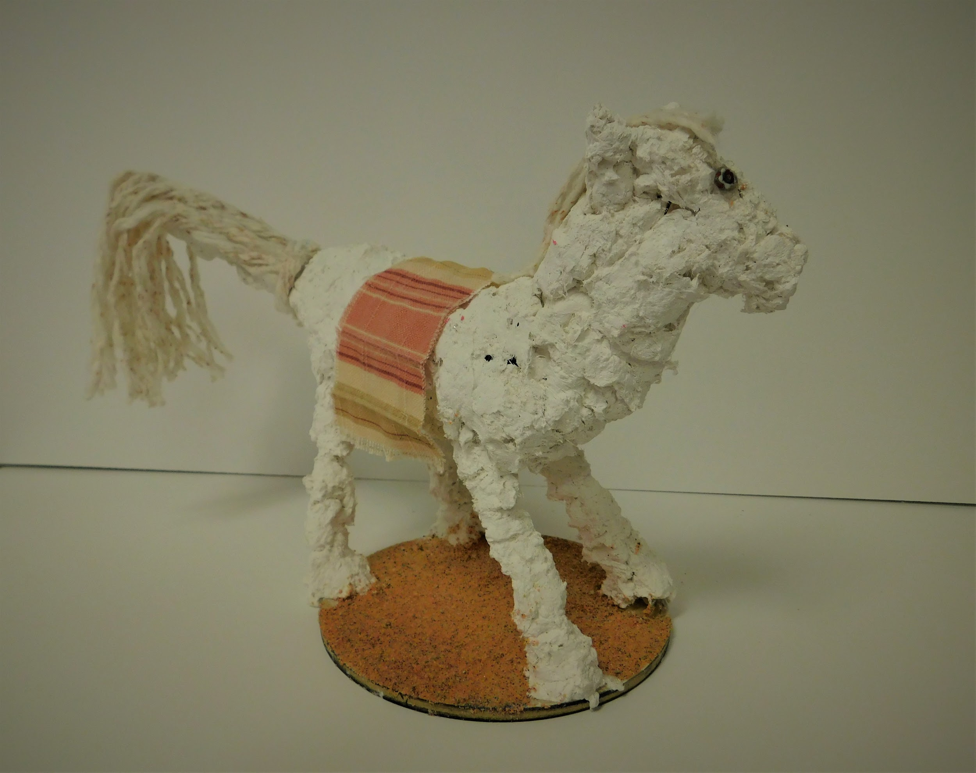
SKITISH PONY
(Sculpture: Davianna R. - 8th Grade)

Slide 26
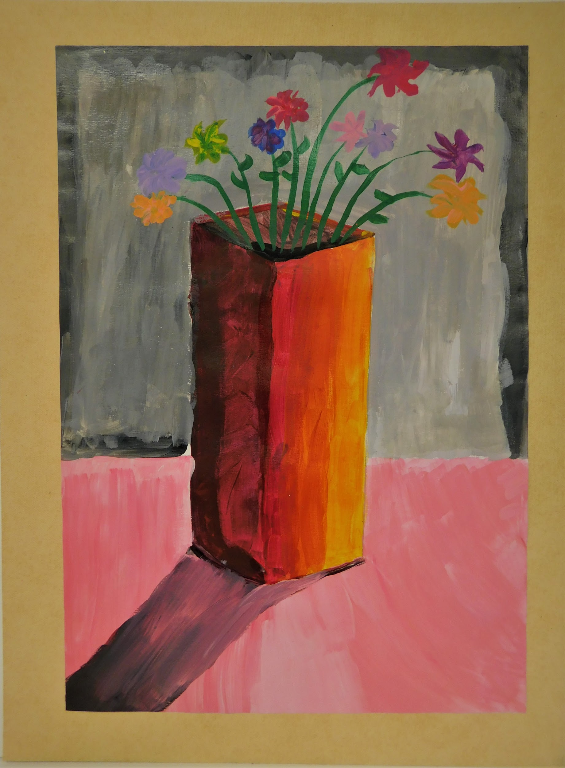
DISBURSING SHADOWS
(Painting: Markeishea J. - 9th Grade)

Slide 27
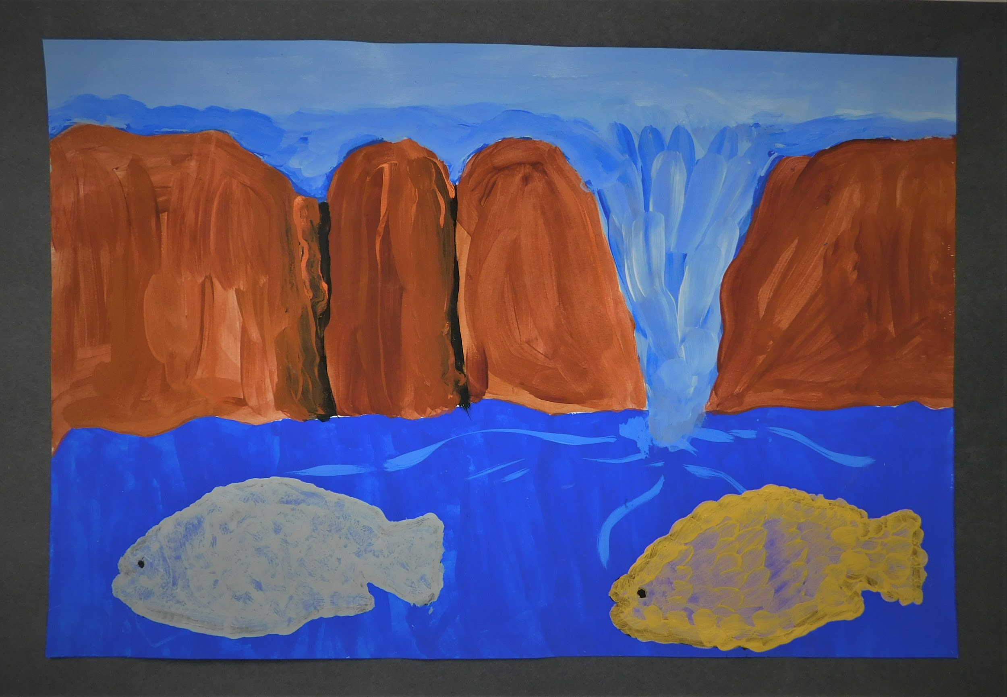
GO WITH THE FLOW
(Painting: JaMya B. - 10th Grade)

Slide 28
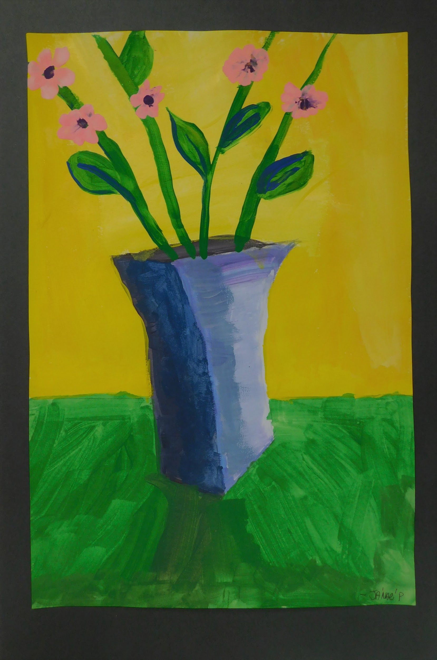
VIVACIOUS
(Painting: JaNae R. - 10th Grade)

Slide 29
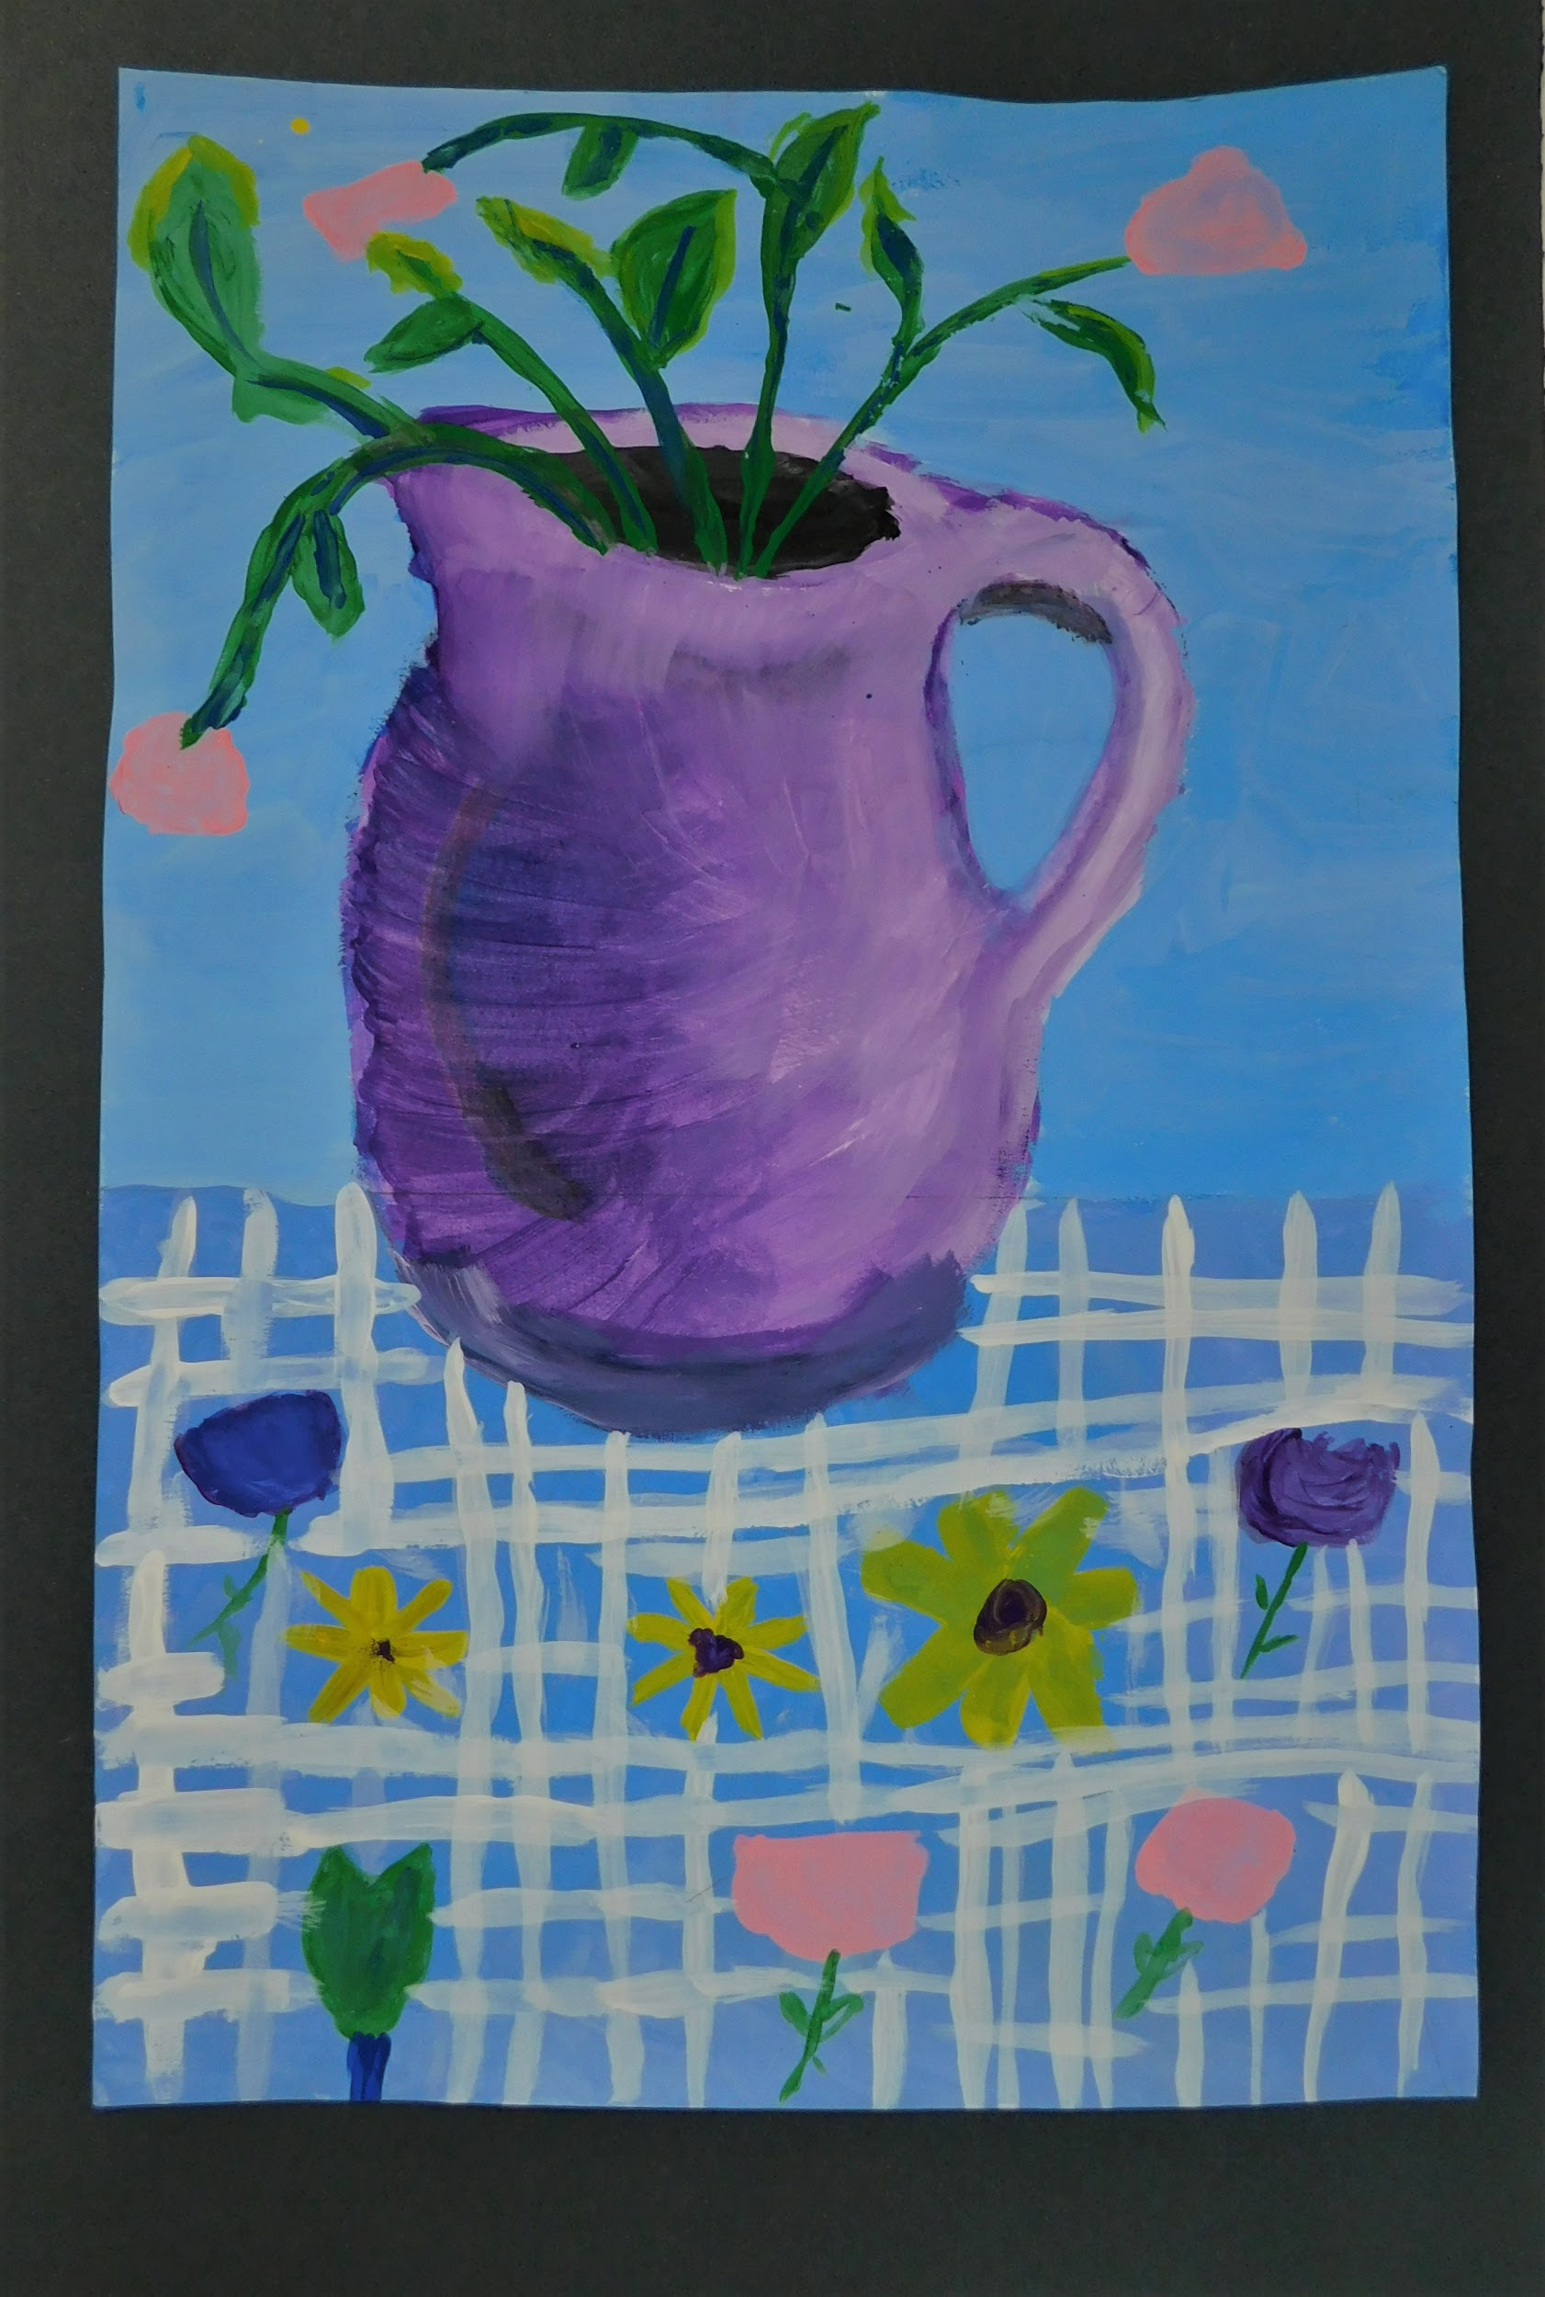
SPRING HAS SPRUNG
(Painting: Nia D. - 11th Grade)

Slide 30
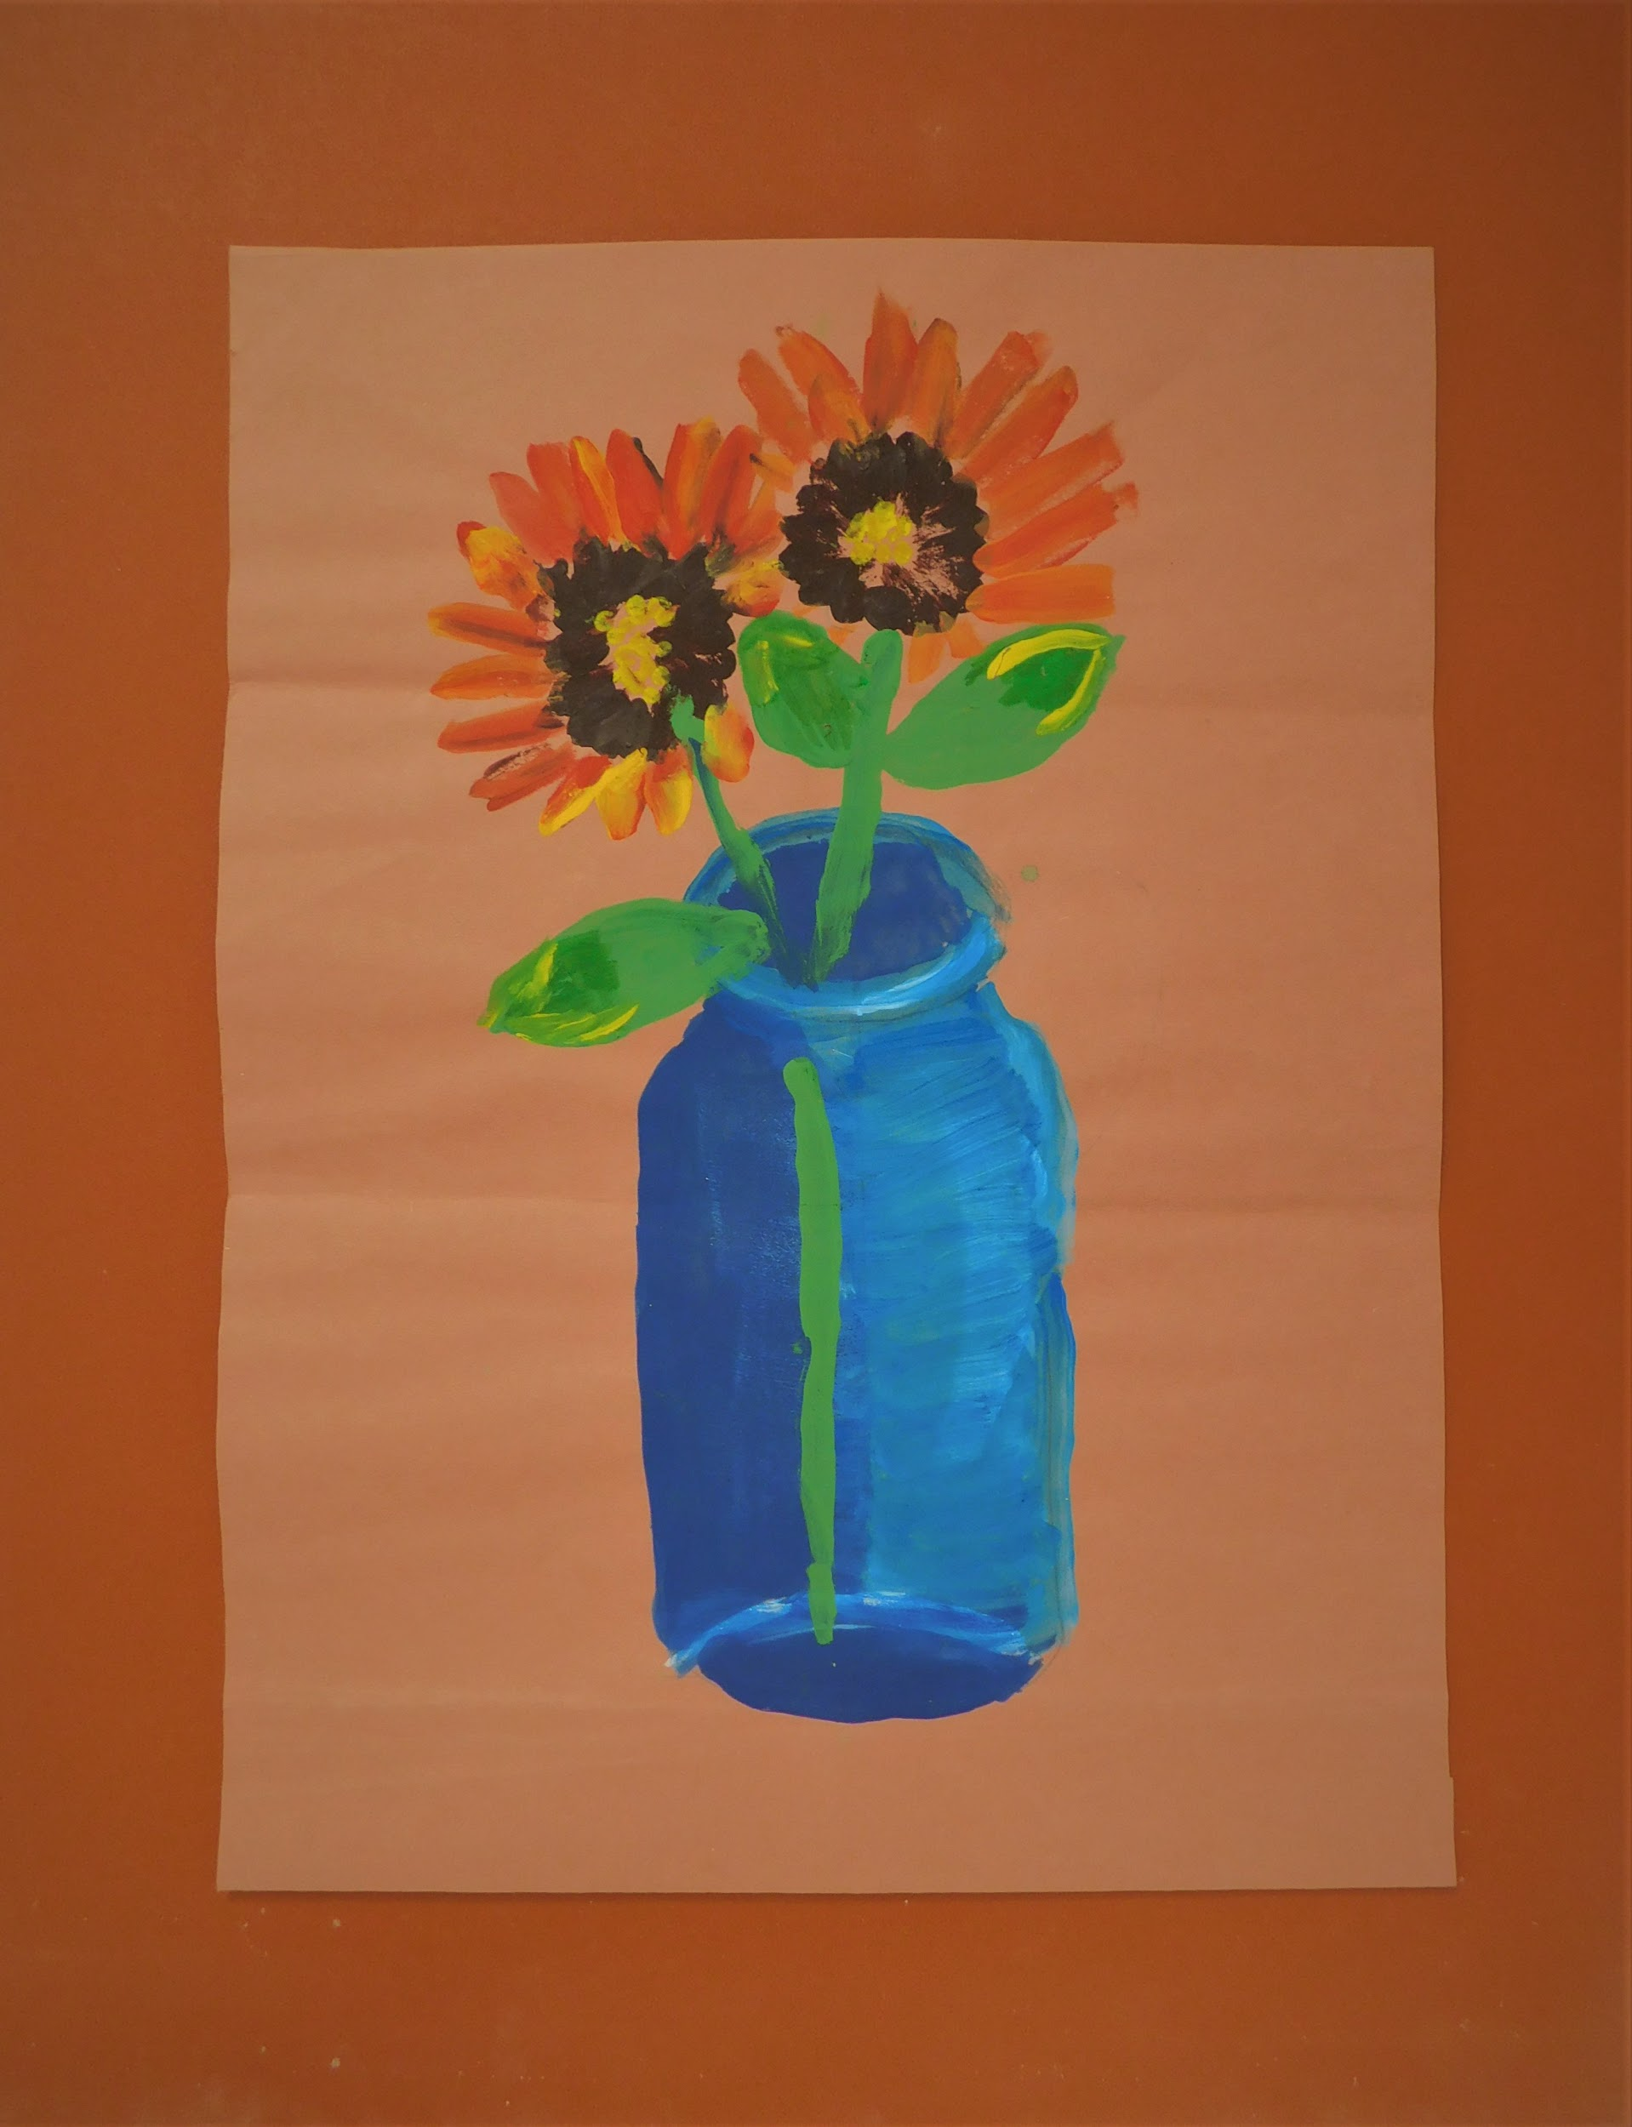
SIPPIN’ SUNSHINE
(Painting: Shaquasia D. - 10th Grade)

Slide 31
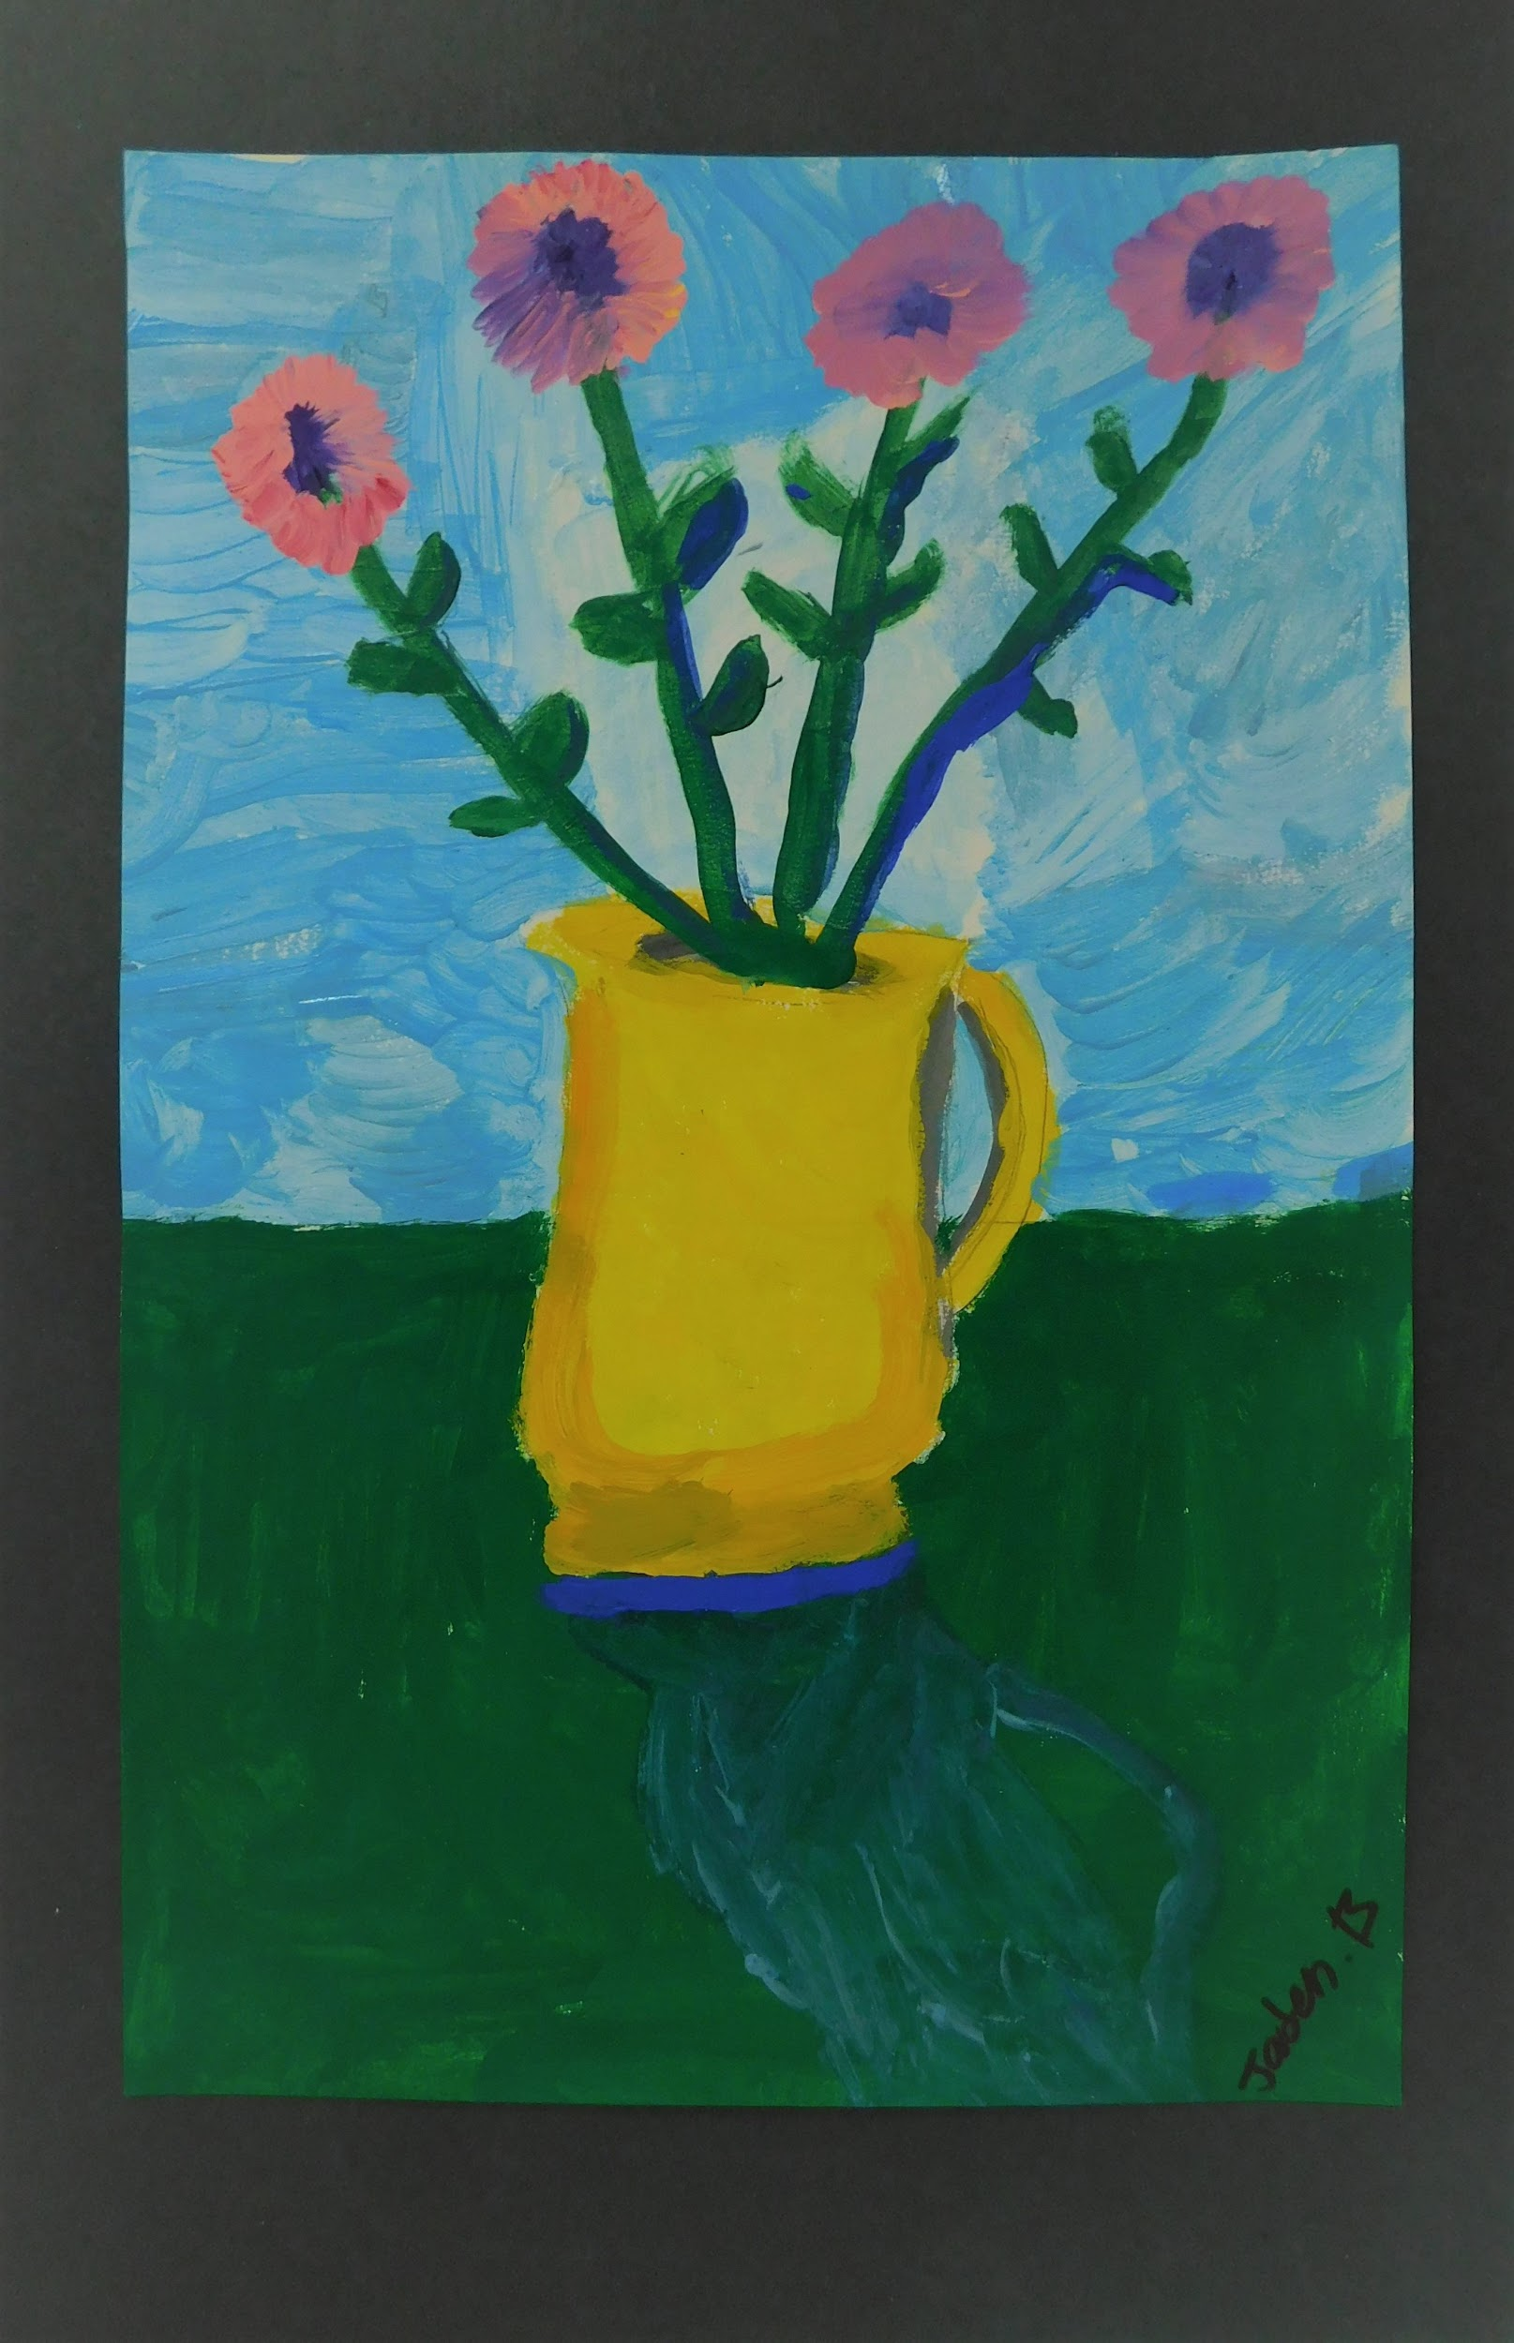
STANDING PROUD
(Painting: 11th Grade)

